Slide 1
Joints

Slide 2
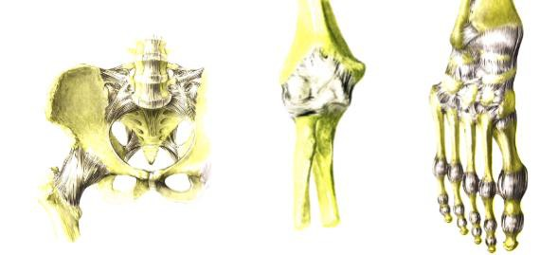
Introduction to Joints
A joint is a point of connection between two bones
Strands of connective tissue, called ligaments, hold the bones together and ensure the stability of joints
Tendon Vs Ligament |Quick Differences and Comparison| - YouTube

Slide 3
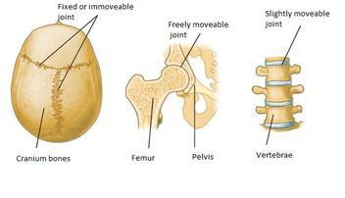
Joint Classification (Function)
Joints are classified according to their motion capabilities:
Syntharoses
immovable
Amphiarthroses
Slightly movable
Diarthroses
Allow the greatest amount of motion

Slide 4
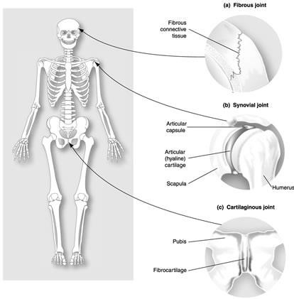
Joint Classification (Structure)
Joints are further classified by the material that joints them:
Fibrous joint
Allow no movement
E.g. sutures of the skull
Cartilaginous joint
Allow limited movement
E.g. intervertebral disks
Synovial joint
Allow large range of movement
Eg: Hip joint

Slide 5
Types of Synovial Joints
There are three basic types of synovial joints:
Unilateral (rotation about only one axis)
Biaxial joints (movement about two perpendicular axes)
Multiaxial joints (movement about all three perpendicular axes)

Slide 6
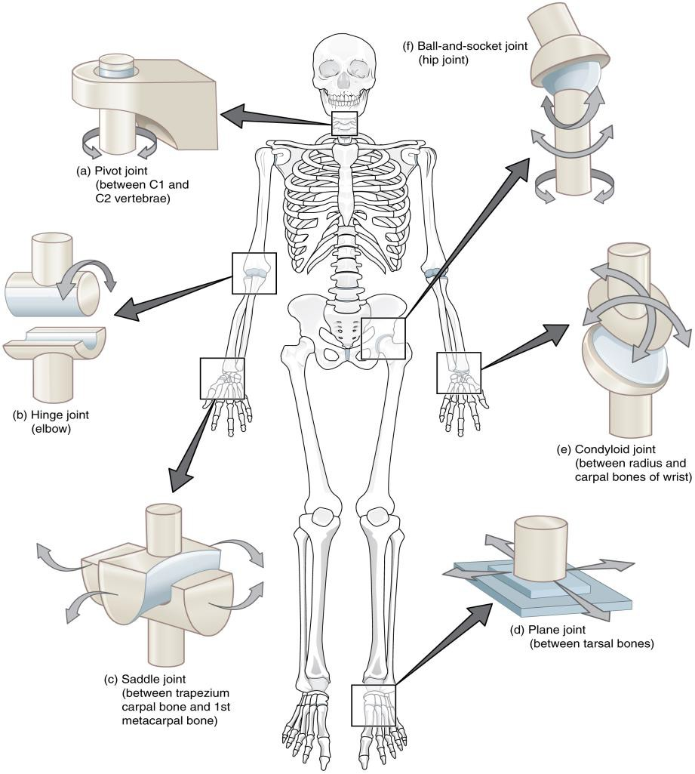
Types of Synovial Joints
Synovial joints are further classified into:
Hinge joint
Pivot joint
Condyloid joint
Saddle-shaped joint
Ball and socket joint
Plane joint

Slide 7
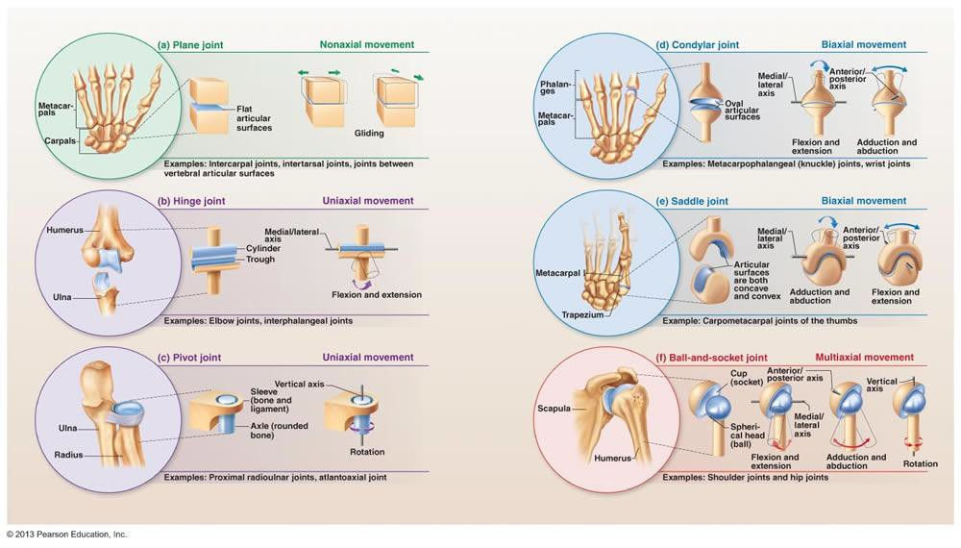
Types of Synovial Joints

Slide 8
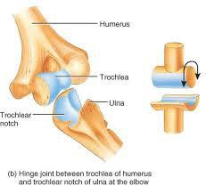
Hinge Joint
Uniaxial
Has one articulating surface that is convex, and another that is concave
E.g. humero-ulnar elbow joint, interphalangeal joint

Slide 9
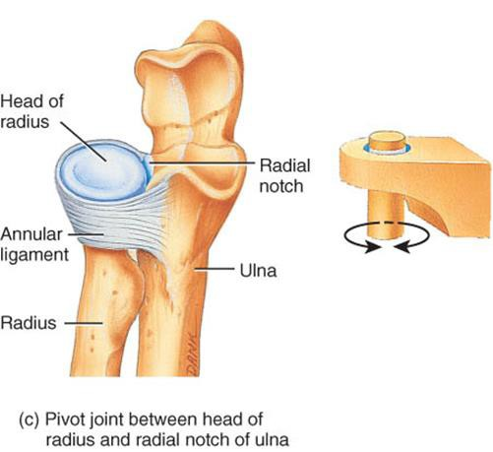
Pivot Joint
Uniaxial
E.g. head of radius rotating against ulna

Slide 10
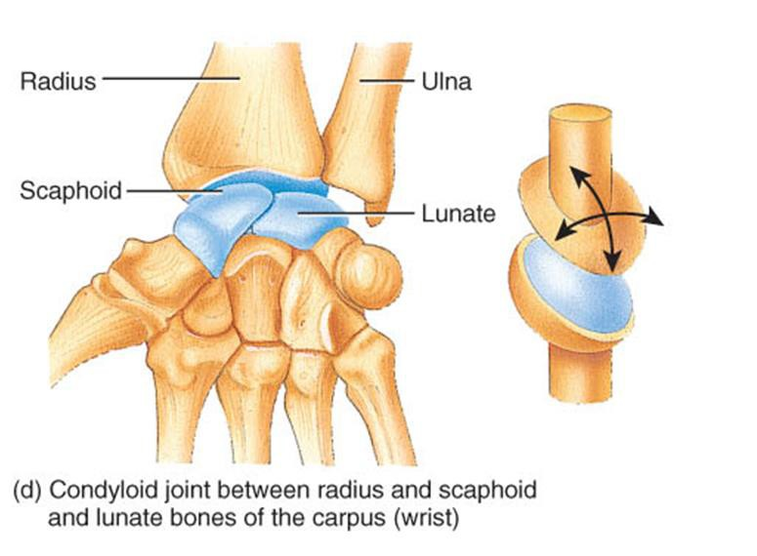
Condyloid (Knuckle) Joint
Biaxial (flexion-extension, abduction-- adduction)
The joint surfaces are usually oval
One joint surface is an ovular convex shape, and the other is a reciprocally shaped concave surface

Slide 11
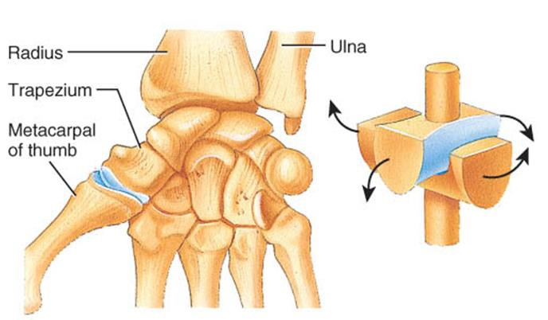
Saddle Joint
Biaxial (flexion-extension, abduction adduction) The bones set together as in sitting on a horse
E.g. carpometacarpal joint of the thumb

Slide 12
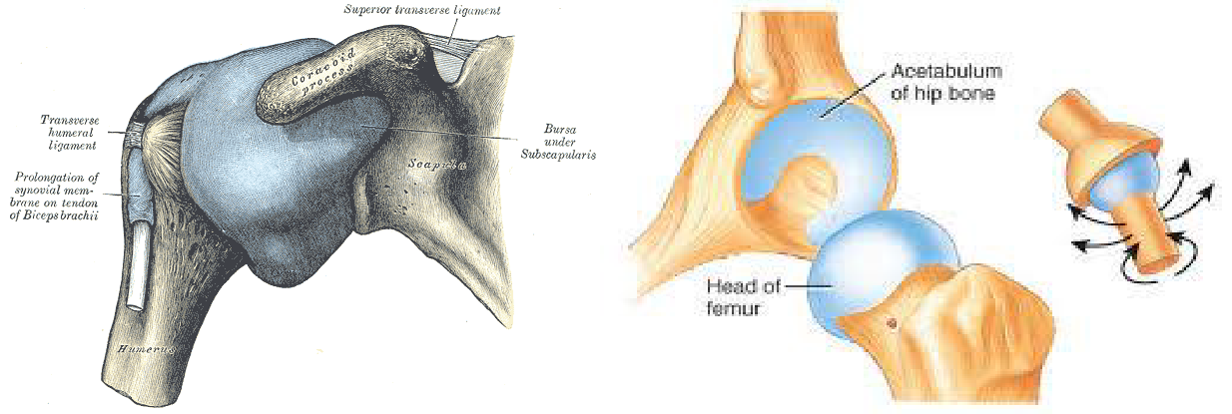
Ball and Socket Joint
Multiaxial rotation (rotation in all planes) A rounded bone is fitted into a cup
like a receptacle
E.g. shoulder & hip joints

Slide 13
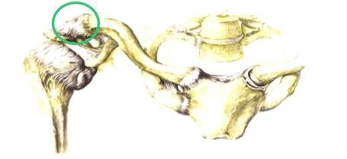
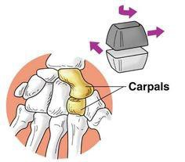
Plane (Gliding) Joint
Uniaxial (permits gliding movements) The bone surfaces involved are nearly flat
E.g. intercarpal joints and acromioclavicular joint of the vertebrae

Slide 14
Characteristics of Synovial Joints
Hyaline cartilage
A protective layer of dense white connective tissue that covers the ends of the articulating bones
Joint cavity Synovial membrane
Covers joint cavity, except over the surfaces of articular cartilages
Secretes the lubrication fluid
Synovial fluid
Lubricates the joints
Capsule
May or may not have thickenings called intrinsic ligaments
Extrinsic ligaments
Support the joint and connect the articulating bones of the joint

