Slide 1
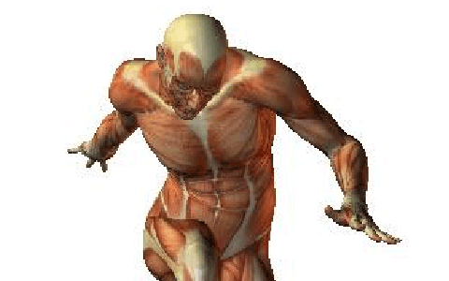
INTRODUCTION: Anatomy or Physiology?
Human Anatomy: The study of the structures that make up the human body and how those structures relate to each other.
Human Physiology: The study of the functions and mechanisms of living things
Difference Between Anatomy and Physiology (thoughtco.com)
The human body’s structures determines function
The structures of the human body are well- designed for efficient movement.

Slide 2
Anatomy first! ANATOMICAL POSITION
Starting reference point for describing the human body
It is universally accepted
it is used in all anatomical descriptions

Slide 3
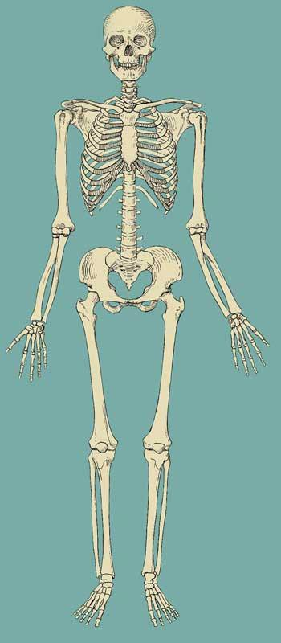
ANATOMICAL POSITION
Standing erect
Facing forward
Arms hanging at the
sides
Palms facing forward
and thumbs outward
Legs straight
Heels, feet and great
toes parallel to each
other

Slide 4
DIRECTIONAL TERMS
All directional terms are based on the assumption that the body is in the anatomical position.

Slide 5
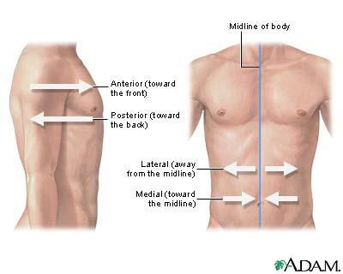
LATERAL-MEDIAL
Lateral- away from the midline of the body
Medial- toward the midline
E.g. Your ears are lateral to your cheeks and your cheeks are medial to your ears

Slide 6
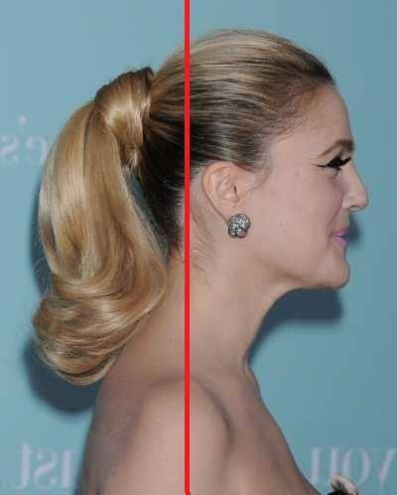
ANTERIOR-POSTERIOR VENTRAL-DORSAL
Anterior- In front of or
front of your body
Posterior – behind or back
of your body
E.g. Your lips are anterior
to your teeth and your
teeth are posterior to your
lips
E.g. In the anatomical
position, your palms are
facing the anterior of your
body

Slide 7
SUPERIOR-INFERIOR
Inferior – Below
Superior - Above
E.g. your lips are superior to your chin and your chin is inferior to your lips

Slide 8
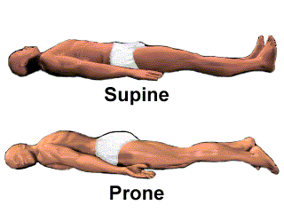
SUPINE & PRONE
SUPINE
Lying on the back
e.g. when performing a bench press
PRONE
Lying face down
e.g. when preparing to perform a push-up

Slide 9
PLANES
Are imaginary flat surfaces that divide the human body
They are used to:
divide the body for further identification of particular areas
describe different movements or actions
Always refer to the body in the anatomical position

Slide 10
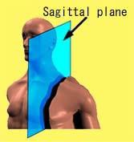
MEDIAN OR MIDSAGITTAL PLANE
A vertical plane that bisects the body into right and left halves
Sagittal plane is any plane parallel to the median plane

Slide 11
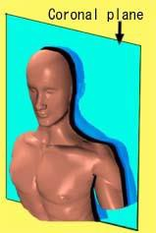
CORONAL OR FRONTAL PLANE
A vertical plane that bisects the body into front and back
It is at right angels to the median plane

Slide 12
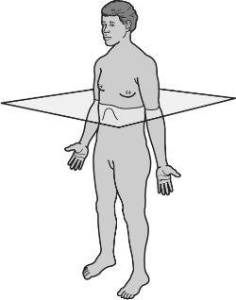
TRANSVERSE OR HORIZONTAL PLANE
A horizontal plane that bisects the body into top and bottom
It’s at right angles to both the median and coronal planes

Slide 13
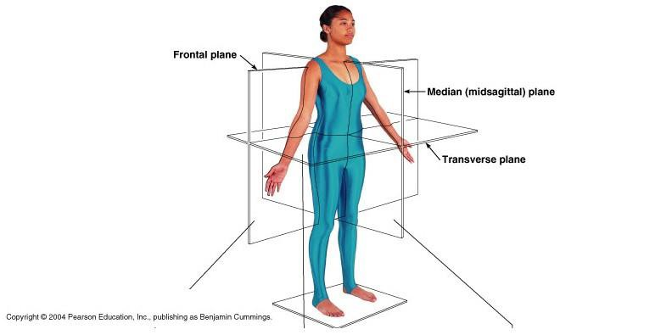
CENTRE OF GRAVITY
The point at which the medial, frontal and transverse planes intersect

Slide 14
ANATOMICAL AXES
A series of imaginary lines
Used to describe the direction of movement at joints

Slide 15
Horizontal axis – extends from one side of the body to the other
Longitudinal axis – is vertical, running from head to toe
Antero-posterior axis – extends from the front of the body to the back
A body movement can be described in terms of the anatomical plane through which it occurs and the axis around which it rotates
The general rule is that the axis of rotation is always perpendicular to the plane of movement

