Slide 1
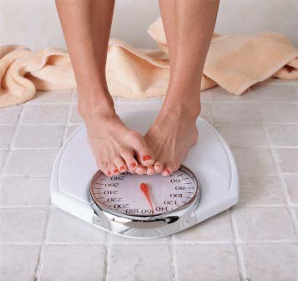
Moles & Mass
Outcome:
Solve problems requiring inter-conversions between moles, mass, volume, and number of particles.

Slide 2
Moles & Mass
Recall that the MOLAR MASS of a substance is how many GRAMS one MOLE will WEIGH.
We can calculate the moles of a known substance given its mass, and vice versa using the molar mass.
We can think of molar mass as a CONVERSION factor.
Ex. The molar mass of carbon is 12 g/mol, which means it takes 12g of carbon to have a mole (6.02x10²³ atoms)
24 g of carbon would contain moles 3 moles of carbon would weigh grams

Slide 3
Moles & Mass
Instead of memorizing formulas, we can use units to help us do calculations…
Ex)

Slide 4
Moles & Mass
Examples:
Calculate the number moles of CO₂ in 6.4g.
Step 1: find the molar mass of CO₂
Step 2: find the moles of CO₂

Slide 5
Moles & Mass
Examples:
Calculate the mass of 0.48 moles of silver nitrate.
Step 1: find the molar mass of AgNO₃
Step 2: find the mass of AgNO₃

Slide 6
Moles & Mass
Try this one…
Calculate the mass of 2.5 moles of oxygen gas.

