Slide 1
Naming Compounds
Maple Leaf Spelling Bee Commercial
Vitamin names
Outcome:
Write formulas and names for polyatomic compounds using IUPAC nomenclature.

Slide 2
Elemental Molecules:
You are responsible for knowing the DIATOMIC molecules.
DIATOMIC Molecules contain 2 ATOMS of the SAME ELEMENT, and are NEVER found as SINGLE
ATOMS.
Hydrogen (H₂) Oxygen (O₂) Fluorine (F₂) Bromine (Br₂) Iodine (I₂) Nitrogen (N₂) Chlorine (Cl₂) Astatine (At₂).
H, O, F, Br, I, N, Cl
→Another diatomic!
NOTE:
Some elements can also exist as POLYATOMIC MOLECULES like S₈ (Sulfur) and P₄ (Phosphorus)

Slide 3
Naming Compounds
We use a standard system of naming (IUPAC – International Union of Pure and Applied Chemistry) to name all chemical compounds.
There is a different way to name chemicals depending on whether they are ionic or covalent
Covalent Bonds | Ionic Bonds
Two NON-METALS Is a SHARING of electrons Ex) CCl₄, CO₂, NO₂ | A METAL and a NON-METAL Electrons are TRANSFERRED Ex) NaCl, CaS, MgH₂

Slide 4
Naming COVALENT Compounds
Writing COVALENT names from formulas:
We use a PREFIX system of NOMENCLATURE to name covalent compounds to show the number of each kind of atom:
mono = 1 | hexa = 6
di = 2 | hepta = 7
tri = 3 | octa = 8
tetra = 4 | nona = 9
penta = 5 | deca = 10
Rules:
The 1st element is named in FULL, using PREFIXES only when there MORE than 1 ATOM (mono
is understood).
The SECOND element is SHORTENED and given an “IDE” suffix, and the appropriate PREFIX.

Slide 5
Naming COVALENT Compounds
Writing COVALENT names from formulas:
Examples:
CO →
CO₂ → SF₆ → N₂O₅ → NO₃ →

Slide 6
Formulas of COVALENT compounds
To find the FORMULA of a COVALENT compound, simply write the SYMBOL and the NUMBER of each atom (SUBSCRIPT) in the order that they are in the name.
Examples:
Sulphur dioxide →
Trinitrogen heptoxide →
Dihydrogen Monoxide →

Slide 7
Naming BINARY IONIC Compounds
Writing IONIC names from formulas:
When naming any ionic compound the name of the CATION (POSITIVE ion) is written first, followed by the name of the ANION (NEGATIVE ion).
→ See “COMMON ION” Side of the PERIODIC TABLE.
Rules:
Name the CATION by writing the FULL NAME of the METALLIC element.
Name the ANION by ABBREVIATING the full name of the NON-METALLIC element and adding the suffix “IDE”.
→NO PREFIXES!!!!! They are not needed!

Slide 8
Naming BINARY IONIC Compounds
Examples:
NaCl →
ZnBr₂ →
Al₂O₃ →

Slide 9
Formulas of BINARY IONIC Compounds
Write the chemical SYMBOL of each element present.
Use your periodic table to obtain the CHARGES on each atom involved in the ionic bond.
COMBINE the atoms so the CHARGES NEUTRALIZE and the resulting compound is NEUTRAL. (criss-cross method or lowest common multiple)
Examples:
Magnesium chloride:
Mg and Cl
Mg has a charge of 2+, Cl has a charge of 1-.
When TWO Cl⁻ ions combine with ONE Mg²⁺ ion, the overall charge is ZERO, therefore
MgCl₂ is a NEUTRAL compound.

Slide 10
Try these ones…
Write formulas for the following binary ionic compounds
Lithium Phosphide
Strontium Nitride
Aluminum Oxide

Slide 11
Naming With Transition Metals
You may have noticed that some ions have ROMAN NUMERALS after their names. These
indicate different OXIDATION STATES.
Some metals can form TWO or MORE IONS due to their ELECTRON arrangement (ex. iron → Fe²⁺ or Fe³⁺)
Writing names from formulas:
We must be able to show which ion is present, so we use ROMAN NUMERALS in BRACKETS:
Ex) Fe²⁺ →
Fe³⁺ →

Slide 12
Transition Metal Examples:
FeCl₂
Notes:
Also try Iron 2 oxide and iron 3 oxide

Slide 13
Try these ones…
Name the following ionic compounds with transition metals
PbCl₄
PbCl₂
Fe₂O₃

Slide 14
Formulas of Compounds with Transition Metals:
This follows the same rules as BINARY IONIC compounds from the previous lesson. Be sure to
use the CORRECT CHARGE in the POSITIVE ion.
Example:
Iron (II) chloride
Fe has a charge of 2+ (as indicated by the Roman numeral, Cl has a charge of 1-
ONE Fe atom combined with TWO Cl atoms results in a NEUTRAL charge
Therefore, the formula is FeCl₂

Slide 15
Try these ones…
Write formulas for the following ionic compounds with transition metals
Cadmium (II) Oxide
Manganese (III) sulphide
Mercury (II) Nitride

Slide 16
Naming With Complex Ions
Complex ions are GROUPS of atoms made STABLE by SHARING ELECTRONS, which then become even more STABLE by GAINING or LOSING ELECTRONS.
Ex) Nitrate → NO₃⁻ Ammonium → NH₄⁺
Unlike NEUTRAL molecules, complex ions carry an ELECTRIC CHARGE and do not exist by themselves.
We follow the naming rules for BINARY IONIC compounds, but we treat the complex ion as a
single ion.

Slide 17
Naming with Complex Ions
The COMPLEX part(s) of the ion are NAMED according to the “ion” side of the periodic table.
Note:
You may see the following names for complex ions:
→ Bicarbonate = HCO₃⁻ (HYDROGEN CARBONATE)
→ Bisulfate = HSO₄⁻ (HYDROGEN SULFATE)
Ex) Baking soda is called sodium bicarbonate, but it can also be called sodium hydrogen carbonate.
Examples:
NaNO₃
ZnClO₃
Pb(SO₄)₂

Slide 18
Try these ones…
Write the names for the following ionic compounds that contain complex ions
(NH₄)₂Cl
NaHCO₃
Mg(C₂H₃O₂)₂

Slide 19
Formulas of Complex Ions
When placing a SUBSCRIPT number after the FORMULAS for a complex ion, the GROUP is first
BRACKETED.
Examples:
Barium sulphate
Aluminum hydroxide
Iron (III) sulphate

Slide 20
Try these ones…
Write formulas for the following ionic compounds that contain complex ions
Copper (I) phosphate
Barium bromate
Magnesium Hydrogen Sulphate

Slide 21
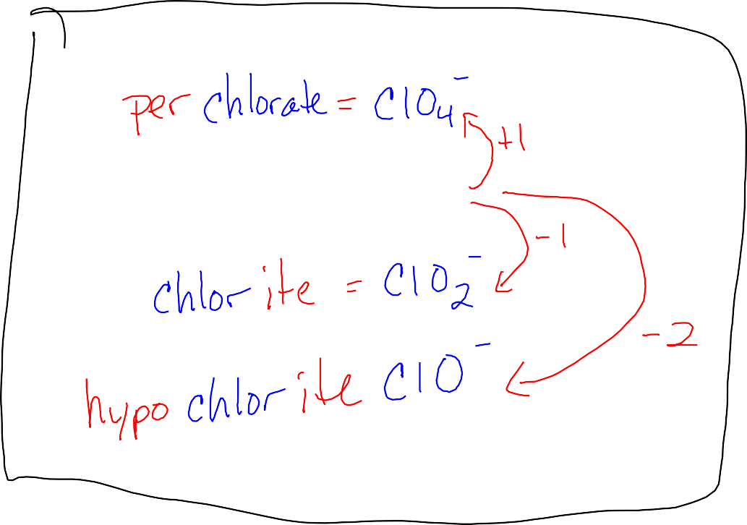
Ionic compounds with different amounts of oxygen
The most common (NORMAL) form of the complex ions that contain oxygen end in “ATE”. We add/change the PREFIX or a SUFFIX for the ANION (negative ion) to indicate how the NUMBER of OXYGEN atoms is different from the NORMAL amount.
Look at Chlorate on the back of the periodic table…
Chlorate = ClO₃⁻
Notice the Pattern!

Slide 22
Ionic compounds with different amounts of oxygen
Rules:
1 more oxygen: use PREFIX “PER” on anion
1 less oxygen: use SUFFIX “ITE” instead of “ate” on anion
2 less oxygen: use prefix “HYPO” and suffix “ITE” on anion
Examples:
NaNO₃
K₃PO₂ Li₂SO₃ Zn(ClO₄)₂

Slide 23
Try these ones…
Write formulas for the following ionic compounds with varied oxygen.
Sodium phosphite
Lead (II) persulphate Lithium silicate
Mg₃(PO₅)₂
Al(NO₄)₃

