Slide 1
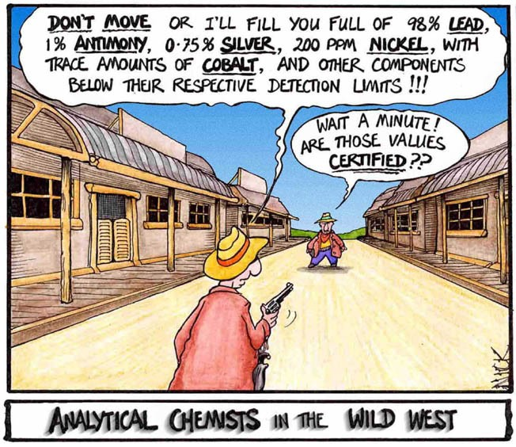
Empirical & Molecular Formulas
Outcome:
Determine empirical and molecular formulas from percent composition or mass data.

Slide 2
Empirical & Molecular Formulas
In a CHEMICAL FORMULA the elements are represented by SYMBOLS, and a SUBSCRIPT number represents the NUMBER of each ELEMENT.
There are different types:
Molecular Formulae:
Represents the ACTUAL NUMBER of atoms of each element
RATHER THAN a RATIO of atoms.
The formulas we have been using all along…
Ex) ethane = C₂H₆

Slide 3
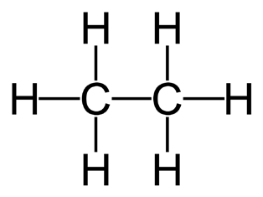
Empirical & Molecular Formulas
Empirical Formulae:
Represents the RATIOS of atoms of each element in the compound.
Is the REDUCED or SIMPLEST form of the molecular formula
Ex) ethane = CH₃
Structural Formulae:
SHOW the BONDS that connect each atom, and the STRUCTURE of the resulting MOLECULE.
Ex) ethane:

Slide 4
Empirical & Molecular Formulas
Percent Composition:
Shows the PERCENTAGE of a COMPOUND`S TOTAL MASS that each ELEMENT TAKES up.
Can be found from the compound’s FORMULA, or by
EXPERIMENT.
^{Mass}Element
100%
^{Mass}Compound
Example:
A 10g sample of propane contains 1.83g of hydrogen. What is the percent composition of propane?

Slide 5
Empirical & Molecular Formulas
Determining Empirical Formulas:
There is a rhyme that we can use to remember the steps…
Percent to mass Mass to moles Divide by Small Times ‘till Whole

Slide 6
Empirical & Molecular Formulas
Examples:
1. A compound has a composition of 40.0% carbon, 6.714% hydrogen, and 53.29% oxygen. Determine the empirical formula.

Slide 7
Empirical & Molecular Formulas
Examples:
2. A compound contains 82.66% carbon atoms and 17.34% hydrogen atoms. Determine the empirical formula

Slide 8
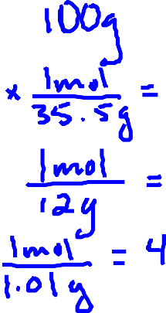
Empirical & Molecular Formulas
Determining Molecular Formulas:
We can use PERCENT COMPOSITION and MOLAR MASS to determine the molecular formula of a compound.
Example:
A compound contains 71.65% chlorine, 24.27% carbon, and 4.07% hydrogen. Find the molecular formula if the molar mass is 98.96 g/mol

Slide 9
Empirical & Molecular Formulas
We can also use the relative masses of the elements to determine the formulas…
Example:
If a compound contains 7.3g sodium, 5.08g of sulphur, and 7.63g of oxygen, find the simplest formula of the compound.

Slide 10
Empirical & Molecular Formulas
Try these ones…
1. A compound was analyzed and found to contain 13.5g Ca, 10.8g O, and 0.675g H. What is the empirical formula for the compound?

Slide 11
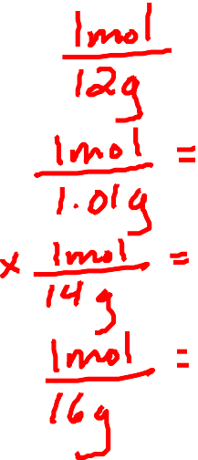
Empirical & Molecular Formulas
Try these ones…
2. NutraSweet is 57.14% C, 6.16% H, 9.52% N, & 27.18% O. Calculate the empirical formula of NutraSweet and find the molecular formula. (The molar mass is 294.30 g/mol)

