Slide 1
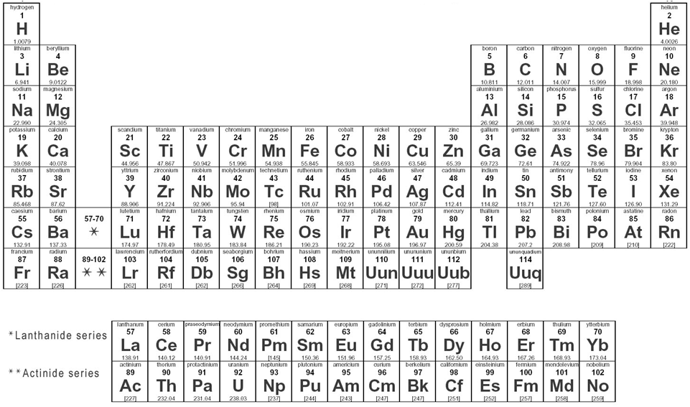
Metals: To the left of the staircase
Non-Metals: To the right of the staircase
Alkali Metals
Noble Gases
Alkaline Earth Metals
Staircase = Metalloids
Chalcogens
Halogens
Transitional Metals
Hydrogen is an exception. It is an explosive gas but is placed in the Alkali metals because it only has 1 electron.
Notes:
What causes elements to combine to form compounds? Why are some elements so reactive compared to others? Electrons are the answer! In particular, those electrons we find on the outer most shell of an atom, the valence electrons. Every atom wants to be like their nearest noble gas, that is, they want to have the same electron configuration. Why do they want to be like them? It's not because they are "noble" and rule the other elements.... it's because they have a full outer shell of electrons, which makes them stable! It turns out that elements that have the same number of valence electrons have similar chemical properties, which is why they are grouped together into "families".

Slide 2
Why Families?
Families are the vertical rows on the periodic table
They share a set of chemical properties
This is why Mendeleev was able to predict the properties of elements that had not been isolated yet
The reactivity of the families is determined by the number of valence electrons

Slide 3
Families and reactivity

Slide 4
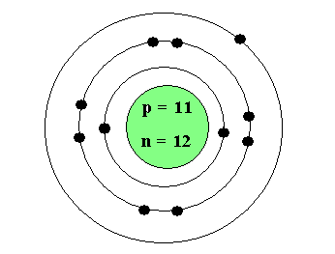
Valence Electrons
The number of electrons in the outer most shell of an atom.
Notes:
Ions
When elements bond to other elements, they do so to have a full outer shell of electrons. With Ionic compounds some elements will gain electrons to get there, and others will lose electrons. Knowing how each element fills up it's outer most shell will tell you the charge the atom will take in an ionic bond.
Ionic Bonding
An ionic bond is a type of chemical bond that involves the electrostatic attraction between oppositely charged ions. Ions are atoms that have lost one or more electrons (known as cations) and atoms that have gained one or more electrons (known as anions).

Slide 5
What makes an element reactive?
All elements want to have a full outer electron shell to become structurally and chemically stable
i.e. they want to have the electron configuration of their closest noble gas
Elements will do this by losing, gaining, or sharing electrons when forming bonds to other elements
The fewer electrons an atom has to lose or gain, the more reactive that element is

Slide 6
Chlorine Gas
https://www.youtube.com/watch?v=YVrmvIDfOac

Slide 7
Reactivity of Alkali Metal
https://www.youtube.com/watch?v=D4pQz3TC0Jo
https://www.youtube.com/watch?v=pPdevJTGAYY
https://www.youtube.com/watch?v=UMqPKQKamhk

Slide 8
Naming compounds
Naming Binary Ionic Compounds and Ionic Formulas
Naming binary ionic compounds follows only two rules: 1) do not change the name of the cation 2) add the suffix "ide" to the anion. for example oxygen becomes oxide Writing Ionic formulas is more complicated and involved taking into consideration how many electrons each ion wants to lose/gain. The key to determining an ionic formula is ensuring that the number of electrons lost is the same as the number of electrons gained (the charges "balance")

Slide 9
Ionic bonding - Multivalent Metals
Most cations in ionic compounds will always have the same oxidation state, that is, they will always lose the same number of electrons. However, the transition metals are unique in that they have multiple oxidation states. Alfred stock realized that there will be a fundamental problem when naming compounds containing the transition metals, so he devised a system using roman numerals to represent the charge of the transition metal ion.

Slide 10
Molecular Compounds (AKA Covalent)
A covalent bond is the sharing of valence electrons between two non-metals in order to achieve a full outer shell of electros. Unlike ionic bonds, it is the attraction between electrons and the opposing atoms nuclei which create these bonds. Remember it is important to learn your greek prefixes in order to accurately describe covalent compounds.

Slide 11
Covalent Molecules are named using PREFIXES since we don`t have charges to show us how they go together.
Examples:
CO
CO2
B2
F3
Trinitrogen pentoxide
sulphur hexafluoride

Slide 12
Polyatomic Ions
Polyatomic ions are exactly as they sound. It is a charged ion composed of two or more atoms covalently bonded together.
Note that we treat the polyatomic ion as a single unit. Thus, when we have more than one of a polyatomic ion in an ionic bond we must put our polyatomic ion in brackets.
Another rule when dealing with polyatomic ions is that you do not change their name when naming an ionic compound.

