Slide 1
What is Structural Efficiency ?
Efficient means to do more with less.
More efficient structures can support more mass compared to the mass of the structure itself.
Structural efficiency = Maximum mass supported
Mass of structure

Slide 2
Calculate the structural efficiency:
This can help to compare how well different structures work!
Example1: 0.5kg box holds a max of 10kg
10 / 0.5 = 20
Example 2: 0.1kg box holds a max of 5 kg
5 / 0.1 = 50

Slide 3
Stress, Fatigue or Failure?
Structural stress - occurs when a combination of external and internal forces act on a structure at one time (this is normal)
Structural fatigue - occurs when a combination of external and internal forces weakens components of a structure (e.g. weakening of beams or concrete).
Structural failure - occurs when the structure itself collapses.

Slide 4
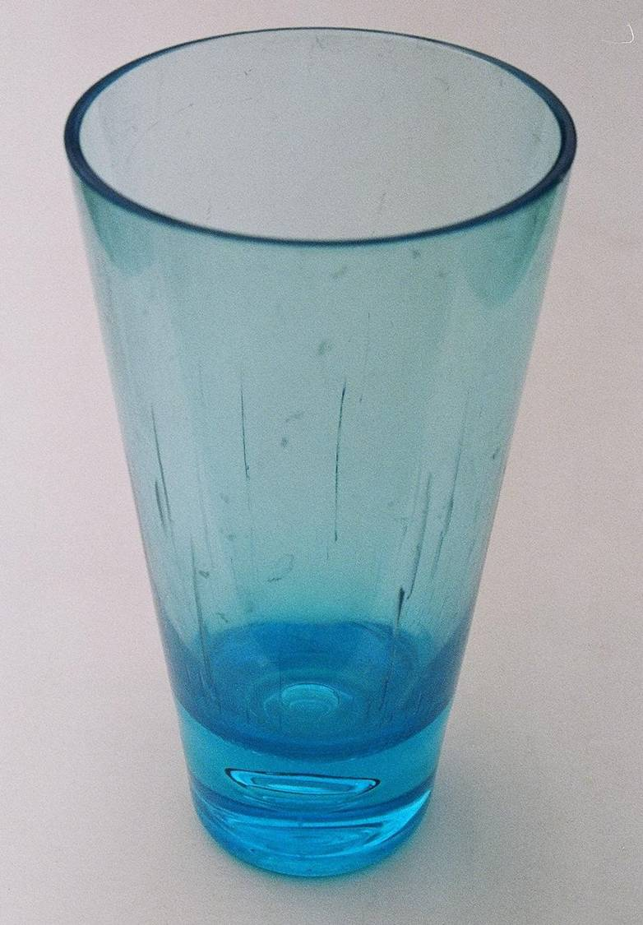
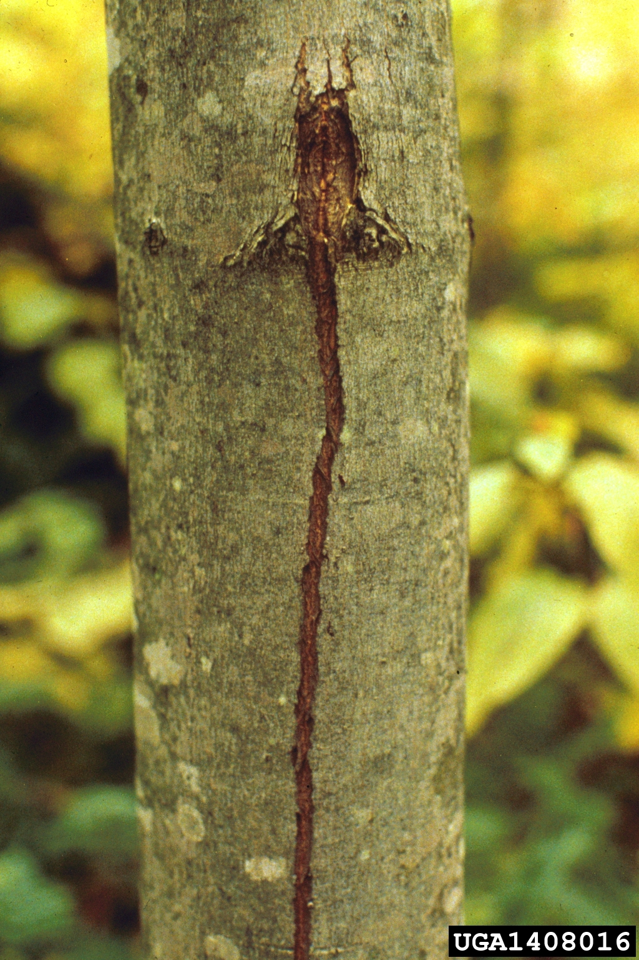
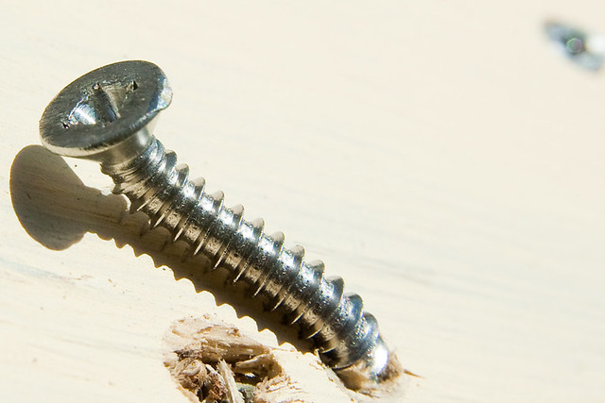
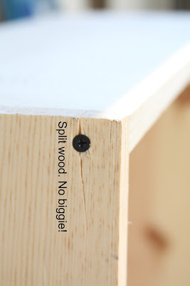
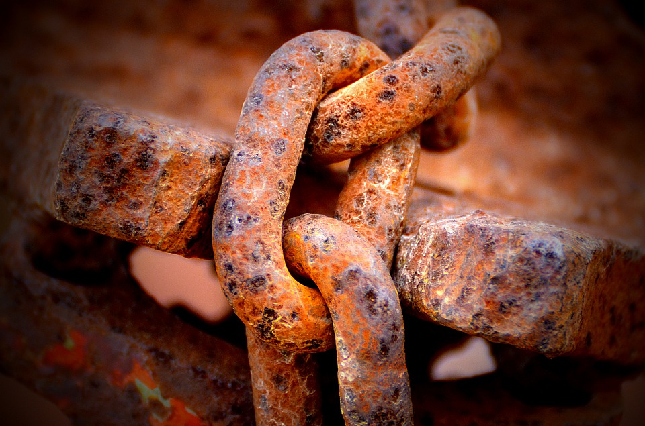
Evidence of Fatigue:
This Photo by Unknown Author is licensed under CC BY
This Photo by Unknown Author is licensed under CC BY-SA
This Photo by Unknown Author is licensed under CC BY
This Photo by Unknown Author is licensed under CC BY-NC-ND

Slide 5
Material Failure
Torsion- twisting can cause material failure. When sections of the structure slide past each other the structure and crack or break in two. When the twisting action makes the structure unusable (not broken) is has failed because it has lost its shape.
YouTube - Tacoma Bridge Disaster

Slide 6
Material Failure
Shear- minor weaknesses in a material can cause failure because the particles move farther apart and are less attracted to each other. This can be cause by compression.
YouTube - House Payload

Slide 7
Material Failure
Bend or buckle- compression can also cause a material to bend and buckle- like a pop can that is stepped on. To prevent this, reinforcements – stringers and ribs- are used to strengthen the structure.
YouTube - Boomer Bridges Are Falling Down: i-35 Bridge Collapse

Slide 8
Making Use of Stresses
Buckle: Car bumpers are designed to buckle in a collision – as the metal fails, it absorbs some of the energy of the impact, which protects the occupants of the vehicle.
YouTube - Lexus bumper

Slide 9
Making Uses of Stresses
Shear: Shear pins are used in outboard motors to prevent failure of the motor (when the propeller gets tangled in weeds), a shear pin breaks and the propeller becomes disengaged with the motor and gears.
http://www.youtube.com/watch?v=d-TJw52PGYs

Slide 10
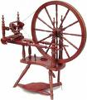
Making Use of Stresses
Twist: Spinning wheels twist cotton or wool fibers so they lock together – making them strong enough to make cloth.
Controlled twisting can also be useful in hair braids, ropes and telecommunication cables.
http://www.youtube.com/watch?v=yrrJLAXwUBU
http://www.youtube.com/watch?v=uejRaFfrOZg&feature=related
http://www.youtube.com/watch?v=kKXca2l0RPo&feature=related

Slide 11
Structural Fatigue Poster Project
• research to find a unique example of a structure that shows signs of structural fatigue and/or failure
• identify the internal and external forces adding to the structural stress causing fatigue or failure, and explain what happened (5 w’s, timeline, evidence, changes made)
• present their information in a labelled poster to be displayed in a gallery or bulletin board display

Slide 12
Structural Components
Structures can be simple and made from one piece (or component), or may be more complex with many pieces joined together.
Complete the chart in your notes by drawing a picture or example of each of the different components listed, and a brief description.

Slide 13
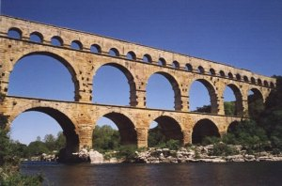
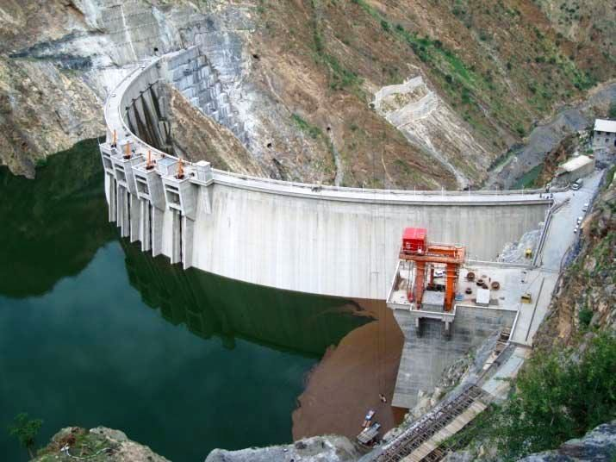
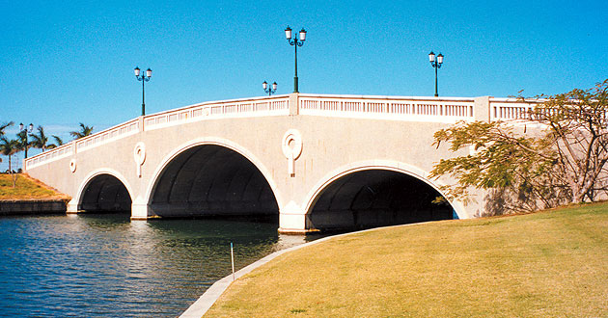
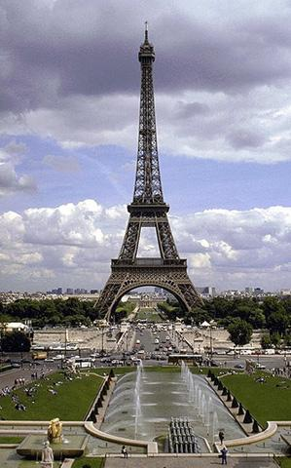
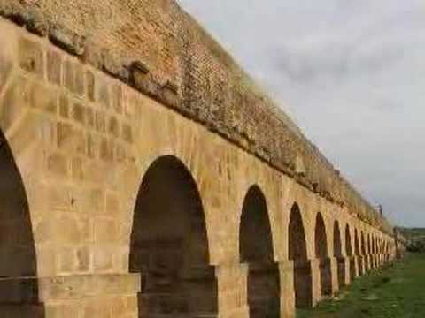
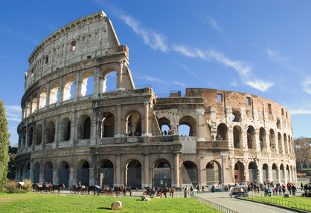
Structural Components - ARCH
Common in many structures including bridges. Strong because the force of the load is spread out across the arch to the foundation.

Slide 14
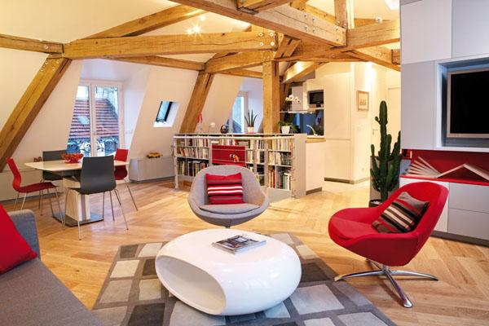
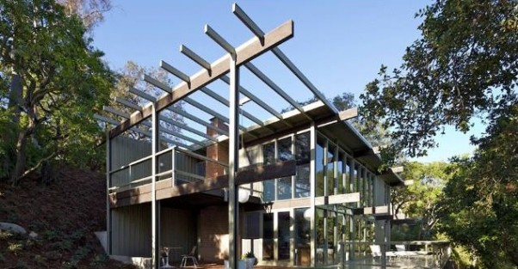
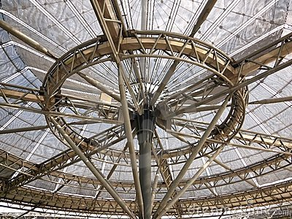
Structural Components - BEAMS
Flat, horizontal structure supported at each end.
Many will break when force is applied to the middle, so other shapes of beams have been developed.

Slide 15
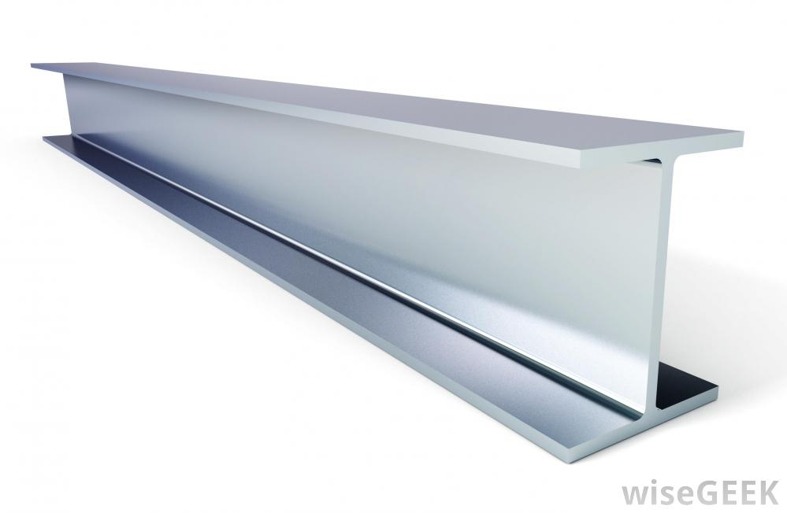
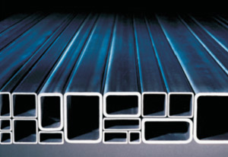
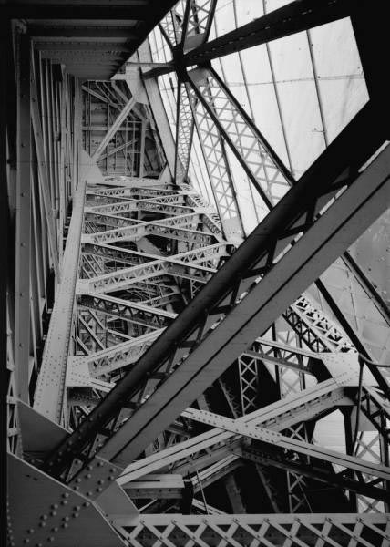
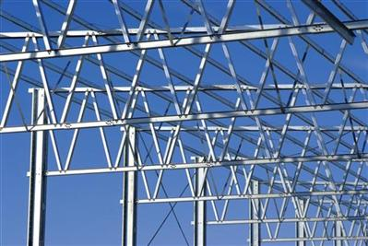
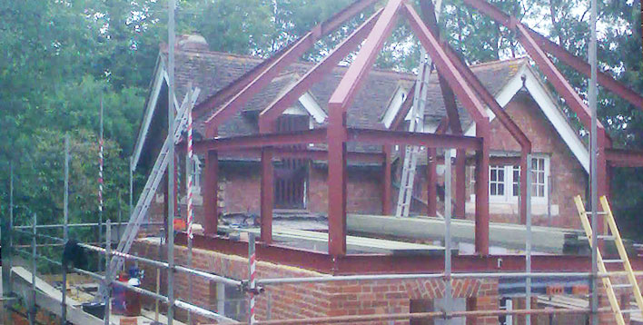
Types of Beams
I-beams and hollow beams can usually hold up under the same amount of force, but require much less material to build.
Why would this be a good thing?

Slide 16
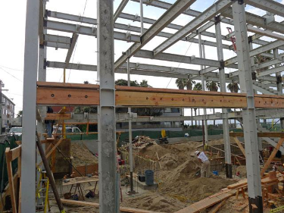
Structural Components - COLUMNS
Vertical supports for floor/roof beams, and the columns of the floor above.
The columns at the bottom floor of a tall building must carry the accumulative weight of all the floors above. This is why the location of columns ideally should be consistent throughout all floors.

Slide 17
Types of Columns
Rectangular Prisms
Cylinders
Butresses
Materials must hold up under
Large compressive forces.
The more columns, the more
you can spread out the force.

Slide 18
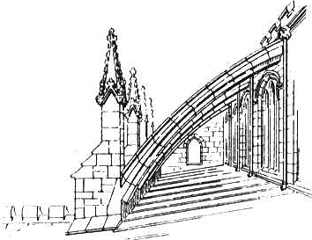
Flying Buttresses
Columns on the outside of a structure that connect to the building near the top and are used to support the outer walls in much the same way that two sides of an arch support each other

Slide 19
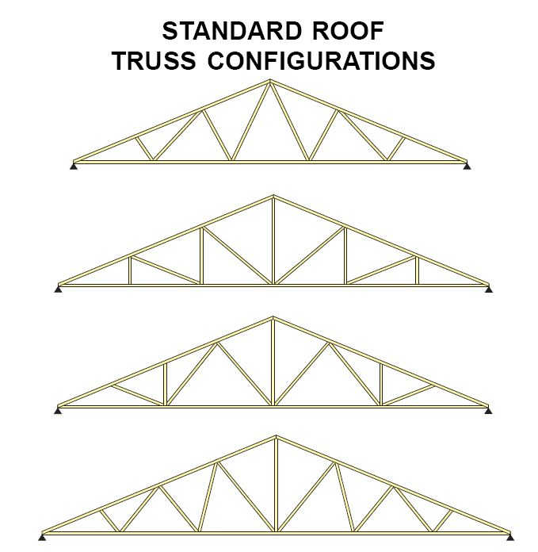
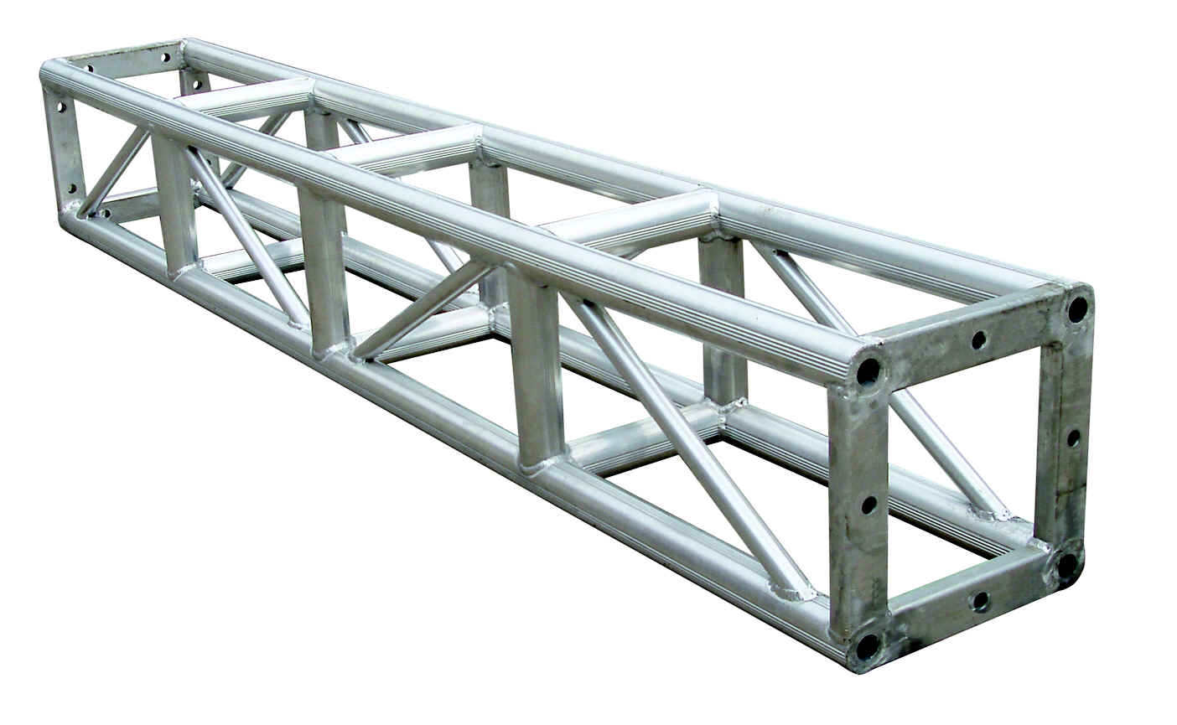
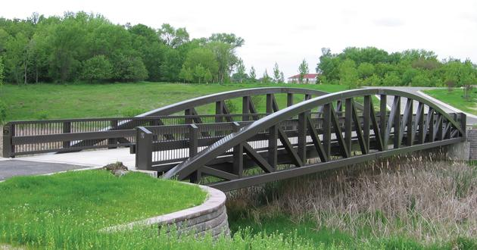
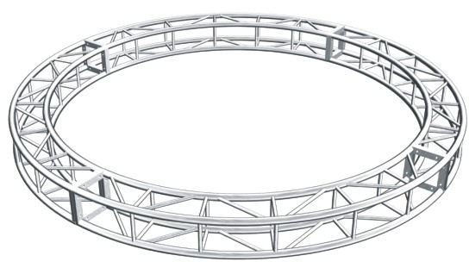
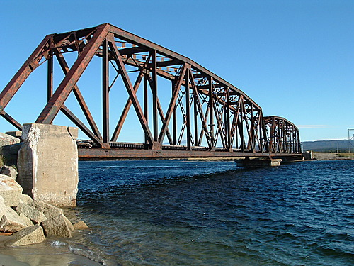
Structural Components - TRUSS
A structure composed of several triangular shapes.

Slide 20
Structural Components - JOINTS
A joint is a place where parts of the structure come together.
Fixed Joint: a joint that does not move. It is intended to keep the structure rigid.
Mobile Joint: a joint that allows the structure to move at certain points.
* all joints require the force of friction to work!

Slide 21
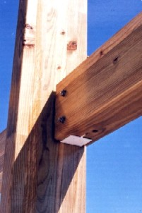
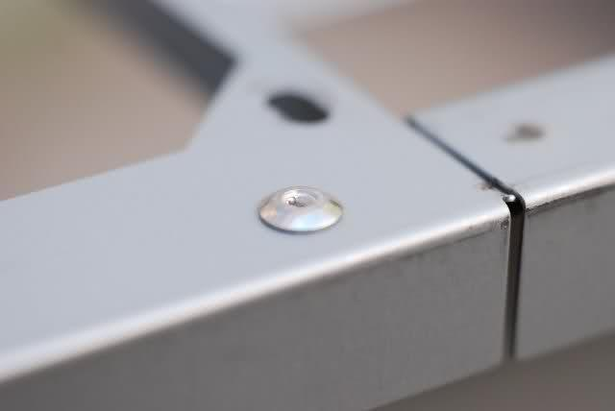
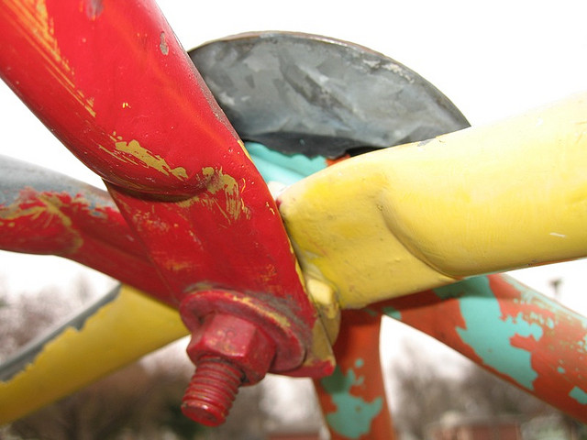
Fixed Joints: Nails, Screws & Rivets
Used in construction.
Make permanent holes in material being joined.
Holes can cause weakening of material.

Slide 22
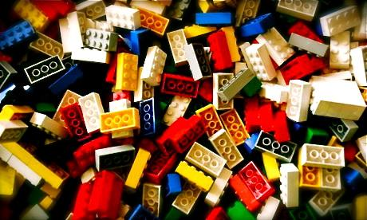
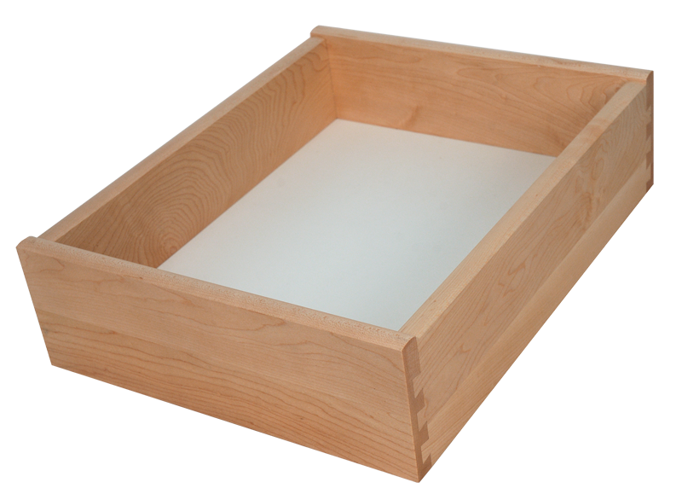
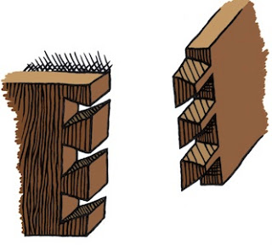
Fixed Joints: Interlocking Shapes
If parts are carefully shaped, they can hold themselves together.

Slide 23
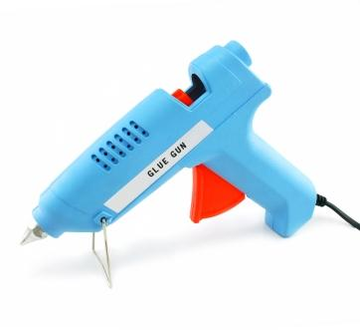
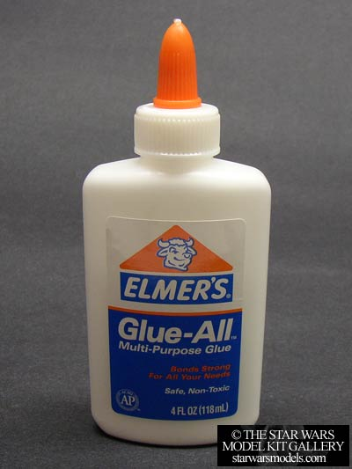
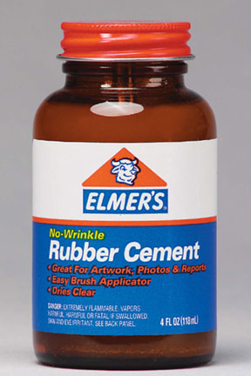
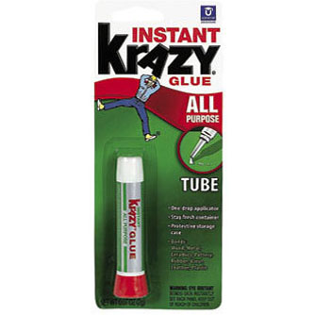
Adhesives
Thermosetting glue - heated to the point of melting before applied to the joint. As it cools, it hardens and holds material together.
Solvent-based glue - made with a liquid that will evaporate quickly. Glue is applied as a liquid and hardens as it dries.

Slide 24
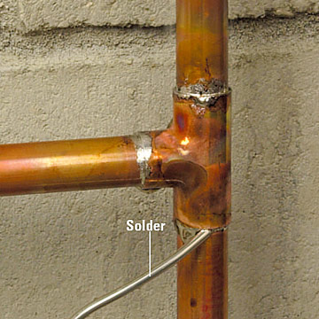
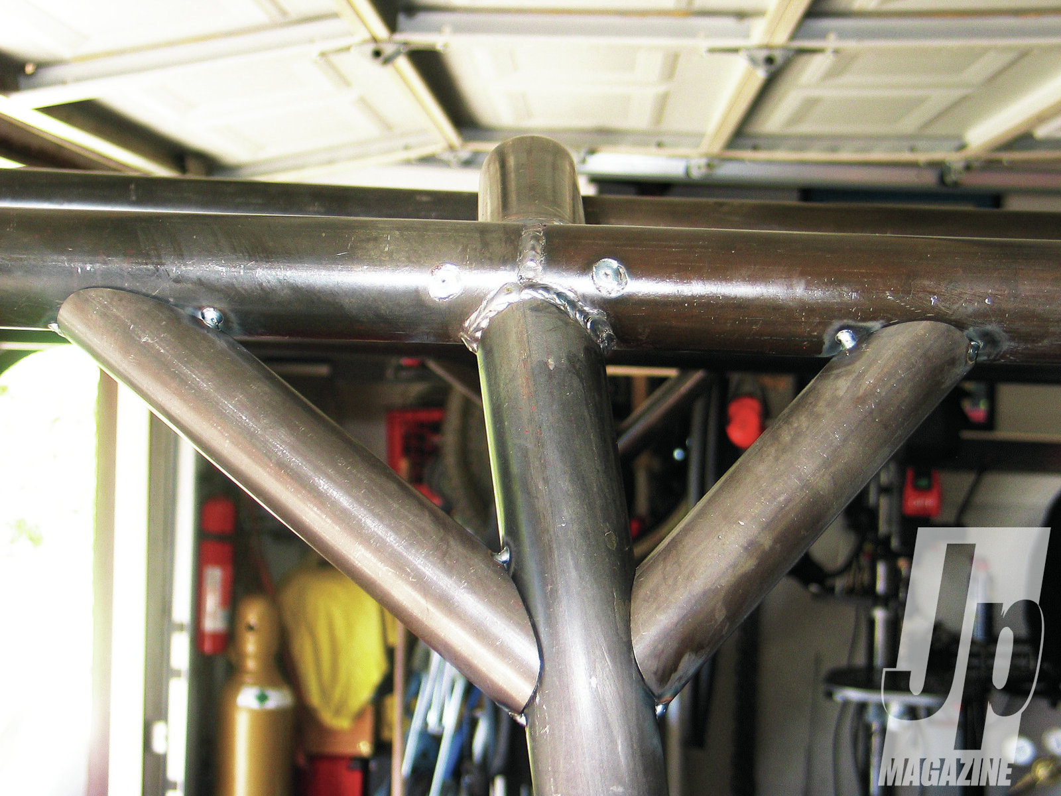
Welding and Soldering
Both require melting a material which will hold the joint together as it cools.
Welding - melts the pieces themselves
Soldering - melts another material around the pieces.

Slide 25
Bridge Design Challenges
Identify key features of the bridges that were most efficient.

Slide 26
Spaghetti Structural Challenge!
Using what you have learned about structural components, you will build one of the following structures:
1. Bridge that will span a 30 cm gap at least between 2 tables. (load in center of span)
2. Tower or skyscraper frame at least 30 cm tall (load in center on top)
You may only use regular spaghetti, and white glue.
Final structure will be tested to find approximate structural efficiency.

Slide 27
Reflection on Test Structures
For EACH structure that you built, answer the following questions:
What was the structural efficiency of your design? How did it compare to the efficiencies of the other designs of your classmates?
What structural components did you choose to include in your design. List them and describe the reason you selected each.
What worked well? Explain.
Where were the shortcomings? Explain. What will you do to try and prevent these in the future?

