Slide 1
Groovy Globules
Exploring Lava Lamps

Slide 2
Pre-Activity Questions
Have you observed a lava lamp first-hand? What did you think of it?
Would you like to own a lava lamp? Why or why not?
Can you think of any mixtures you have seen that have globules in them? Is there anything you have tried to mix that has distinct layers?

Slide 3
What is the Kinetic Molecular Theory?
To understand how lava lamps work, you have to understand Kinetic Molecular Theory. It states that all matter is made up of molecules that are always moving. These molecules have kinetic energy. The amount of energy depends on the temperature. When it’s hotter, molecules have more energy. And when they have more energy, they move faster.
There are three most common states of matter. What are they?
The molecules in solids have the least energy. That means they move more slowly than molecules in liquids and gases.
The molecules in gases have the most energy of all. They move the fastest.

Slide 4
Particle Theory & Energy
There are three most common states of matter.
The molecules in solids have the least energy. That means they move more slowly than molecules in liquids and gases.
The molecules in gases have the most energy of all. They move the fastest.

Slide 5
How Is Kinetic Energy Related to Density?
Kinetic molecular theory can help you understand density. Density refers to how much matter there is in a given volume of space.
Have you ever thrown a coin into a fountain or a rock into a pond? You probably noticed that these objects sink in water. And you’ve probably noticed that other objects, like twigs, float on water. The objects that are denser than water sink. And the objects that are less dense than water float.
But what does this have to do with lava lamps? Remember the globules - let’s call them “globs” for short - that float around? At room temperature, the globs are a bit denser than the surrounding liquid. That’s why they sit at the bottom of the lamp. But when you turn the lamp on, the globs heat up. The molecules move faster. The globs become less dense than the surrounding liquid. They rise and start to float around!

Slide 6
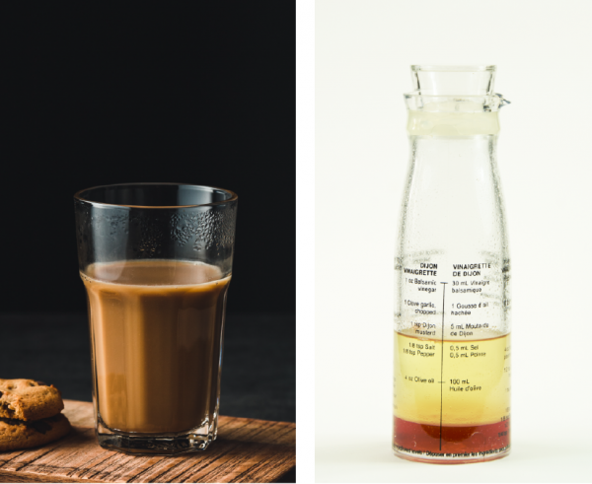
Mix it up!
How does the ability to mix affect how a lava lamp works?

Slide 7
So why don’t the globs of wax in a lava lamp mix with the surrounding liquid?
Think about chocolate syrup and milk. They can mix to form a homogeneous mixture. The chocolate syrup mixes completely with the milk to form yummy chocolate milk!
But some don’t mix with each other –they are heterogeneous mixtures. It all depends on the force of attraction between the molecules in the two liquids.
For example, what happens when you try to mix oil and vinegar - like in a salad dressing?
But chocolate syrup molecules are attracted to milk molecules. And milk molecules are attracted to chocolate syrup molecules. That’s why you get chocolate milk and not a lava lamp in a glass!
Notes:
The molecules in the vinegar are more attracted to each other than to the molecules in oil. The molecules in oil are more attracted to each other than to the molecules in the vinegar. No matter how much you shake or stir your dressing, they will never stay mixed together.

Slide 8
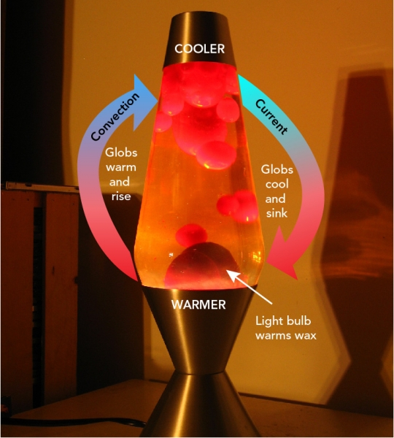

Slide 9
Why Do the Globs in a Lava Lamp Move Around?
One of the most interesting features of a lava lamp is the way that the globs float around. But why does this happen? You know that the globs are less dense than the surrounding liquid. And you know that the globs and the liquid are immiscible. So why don’t the globs just rise to the top of the lamp and stay there?
Well, lava lamps are designed so that the temperature at the top is a bit cooler than at the bottom. And what happens to molecules when they cool down? That’s right! They lose energy and move closer together. So when a glob reaches the top of the lava lamp, it contracts. It becomes denser than the surrounding liquid and begins to sink. When it reaches the bottom, the whole cycle repeats!
A lava lamp is an example of a convection current. Convection currents cause liquids and gases to rise and fall because of changes in their density. There are convection currents all around you, even in the Earth’s crust!

Slide 10
Convection!
A lava lamp is an example of a convection current. Convection currents cause liquids and gases to rise and fall because of changes in their density. There are convection currents all around you, even in the Earth’s crust!

Slide 11
Making connections:
Provide examples of convection currents in the natural environment.
You might have seen the word “homogenized” on a carton of milk or on a jar of peanut butter. What does this mean? Why is this done by food manufacturers?

Slide 12
Make your own!
Want to Try a Lava Lamp Experiment?
You can build your own lava lamp in your classroom or at home! Here’s what you’ll need:
A transparent container, like an empty water or soda bottle
Water
Vegetable oil
Food colouring
An effervescent tablet (like Alka-Seltzer®)
A flashlight (optional)
How to make a lava lamp:
Fill one quarter of the bottle with water
Add food colouring
Fill the rest of the bottle with vegetable oil
Add half an effervescent tablet
Optional: if you have a flashlight, go to a dark room, turn on the flashlight and watch your groovy new lamp in the dark!
And there you have it: your very own lava lamp. Watch what happens to these immiscible liquids. Pretty groovy, don’t you think?

Slide 13
Create a T-chart, to compare and contrast heterogeneous and homogeneous mixtures
Lava Lamps Exploration:
Connecting Particle theory and Mixtures

Slide 14
Big Ideas:
What is kinetic energy? How does kinetic energy change matter?
How does the Kinetic Molecular Theory help explain changes in the density of matter?
How does the Kinetic Molecular Theory explain what happens to water as it changes states from solid ice to liquid water and then to water vapour or steam?
How are convection currents formed in a lava lamp? How are convection currents formed under the Earth’s crust?

Slide 15
Taking it to the next step:
How would you market a lava lamp to kids so that it was both cool and educational? What message would you give about the product so that kids would want to buy one

