Slide 1
Force
Push or a pull that causes a structure to move or change shape.
Effect of a force on a structure depends on:
- magnitude (strength) of the force
- direction of the force
- location where the force is applied

Slide 2
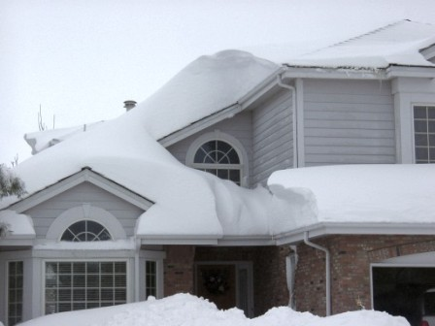
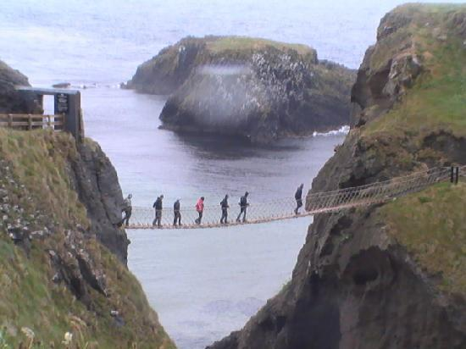
Loads
External force acting on a structure.
Examples:

Slide 3
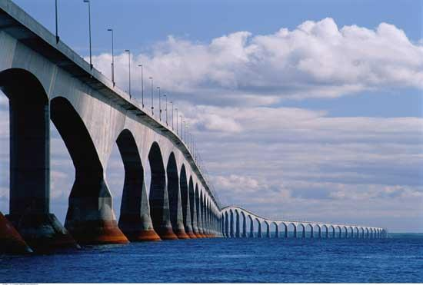
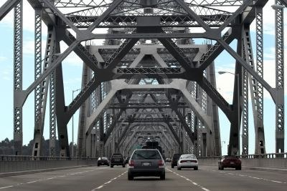
Static vs. Dynamic
Static Load: a non-moving, non-changing load
Dynamic Load: a load that moves or changes over time

Slide 4
External Forces
A force applied to the structure by something else.
Eg. wind, loads (people, snow), gravity
In order to withstand this, the object must be supported at its center of gravity.
Bending Challenge!
The most common way to increase gravitational stability is to widen the base of the structure
Notes:
Bending challenge is where you have a student stand with their heels and butt against the wall and bend forward - hinging at the waste only - and try to pick up something you have put right in front of their toes.

Slide 5
Internal Forces
A force that one part of the structure exerts on another part of the same structure - in other words, the forces within the structure.
Usually this is caused by an external force.
When we design a structure, we need materials that can withstand these forces.

Slide 6
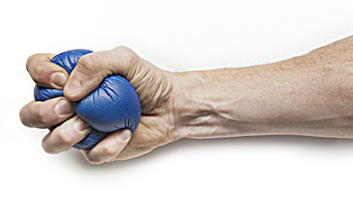
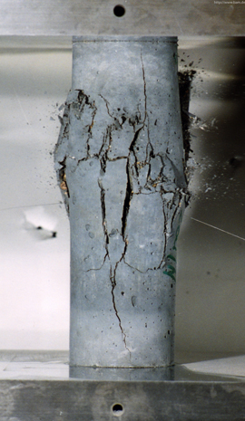
Compression
A force that acts to squeeze an object or parts of an object together.
Materials buckle when they fail under compression.
Concrete has high compressive strength

Slide 7
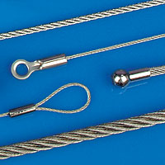
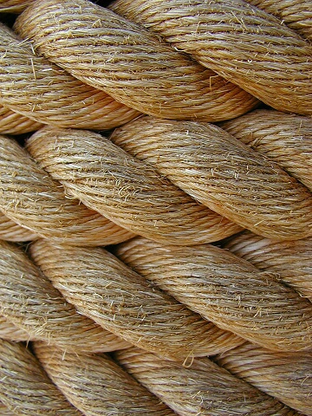
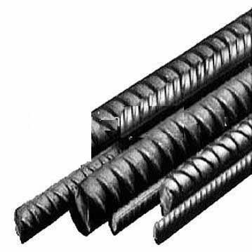
Tension
A force that acts to stretch or pull objects apart.
Materials fracture or tear when they fail under tension.

Slide 8
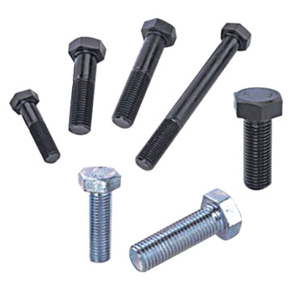
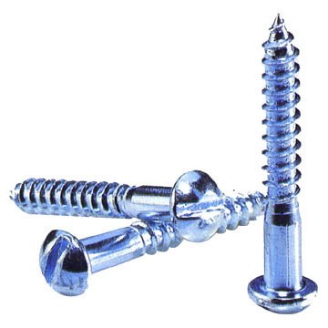
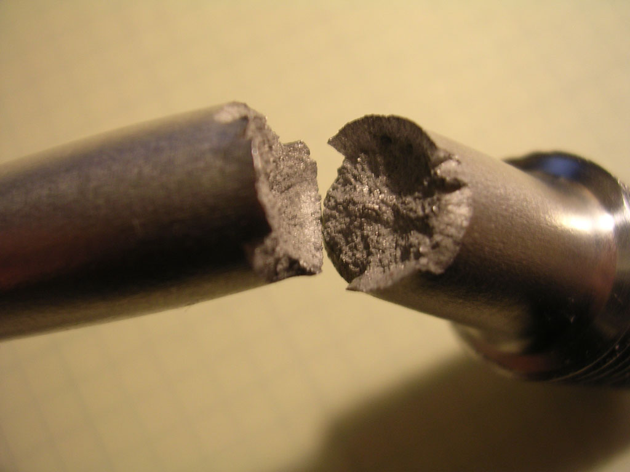
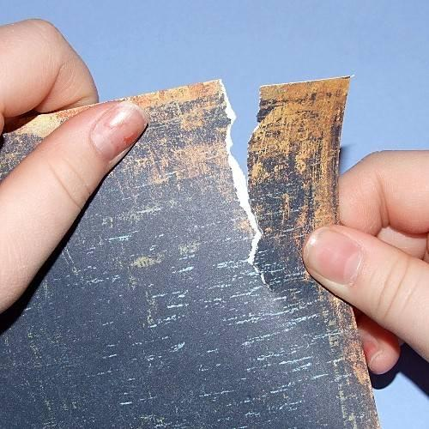
Shear
A force that acts to push parts in contact with each other past each other in opposite directions.
Materials tear or fracture when they fail under shear.

Slide 9
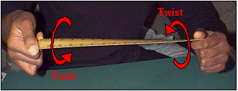
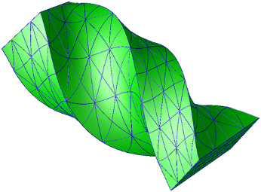
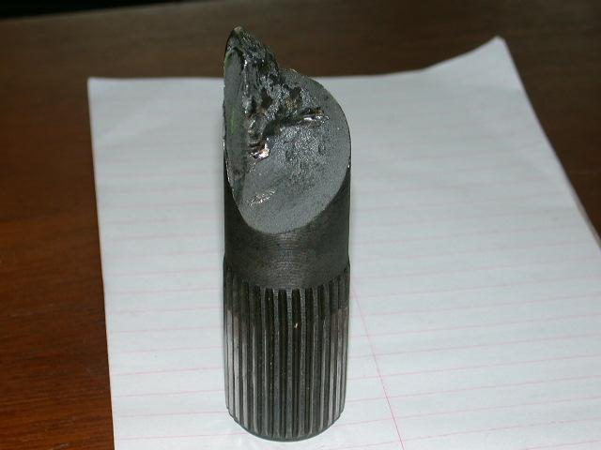
Torsion
A force that twists an object.

Slide 10
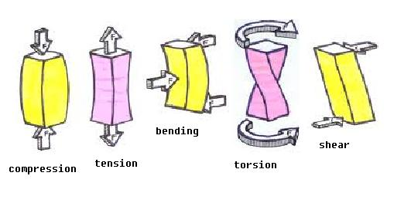
Summary

Slide 11
Create a Flow Chart / Graphic Organizer for Structural Forces
Include the following vocab words:
External forces
Internal forces
Static
Dynamic
Gravity
Compression
Tension
Torsion
Shear
Bending

Slide 12
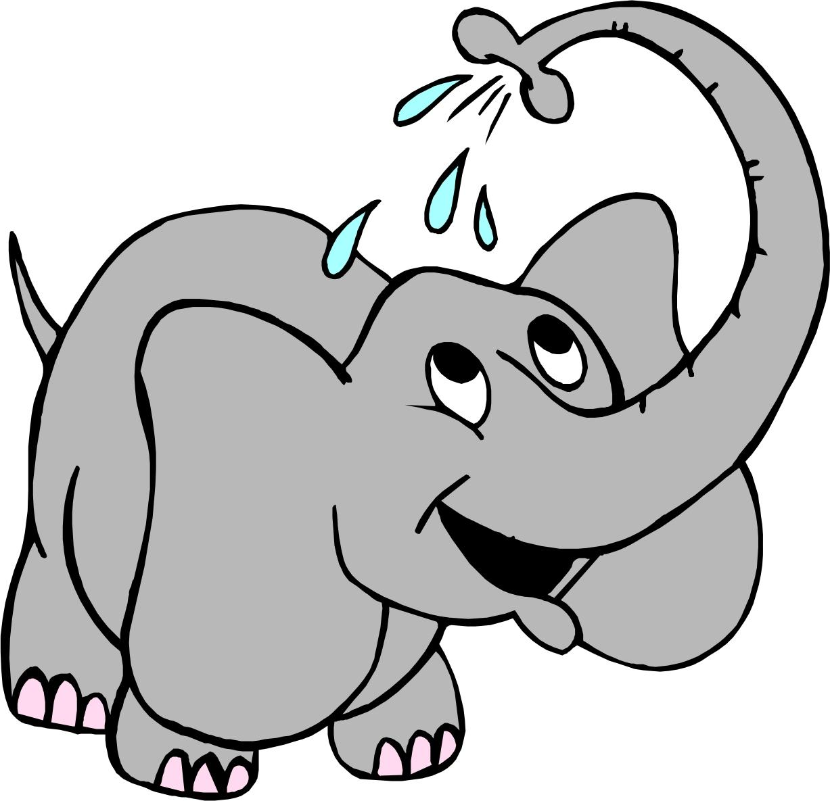
Mass vs Weight
Mass is the amount of matter in an object.
Measured in grams (g)
Remains the same no matter where the object is.
Weight is a measure of the FORCE acting on an object.
Gravity is the biggest force affecting weight.
Weight can change depending on gravity.
Measured in NEWTONS (N)
http://www.bbc.co.uk/bitesize/ks3/science/energy_electricity_forces/forces/activity/

Slide 13
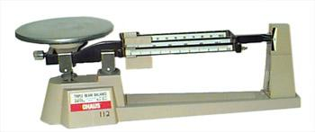
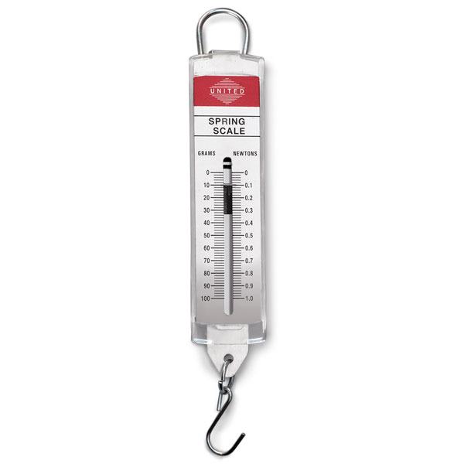
Measuring Mass and Weight
To measure mass we use a balance.
To measure weight, we use a spring scale.

Slide 14
Activity
Using the Triple Beam Balance and the Spring Scale, measure the mass and weight of 3 different objects in the classroom.
Record your values in a neat table with a title.
Be ready to discuss in 10 minutes!
What do you notice about mass vs weight?

Slide 15
Mass vs Weight Continued
On Earth, gravity pulls on each kg of mass with approximately 10 N of force.
So to find the weight of an object on Earth, we multiply the mass (in kg) by 10 N/kg.
Example:
A grade 7 student has a mass of 40 kg, what is his weight?

