Slide 1
Conduction, Convection or Radiation

Slide 2
Conduction
Heat transfer occurs in solids.
As particles of matter collide with other particles, heat energy moves from one particle to another.

Slide 3
Convection
Heat transfer in fluids (gases / liquids)
Particles in matter collide as the fluids move, creating more space between particles and making the fluid less dense. Less dense fluids move upwards, and more dense fluids move down to take up the available space.

Slide 4
Radiation
Transfer of heat energy by waves.
Waves do not need matter to travel through (no particles needed!) and so they can travel through empty space or a vacuum.

Slide 5
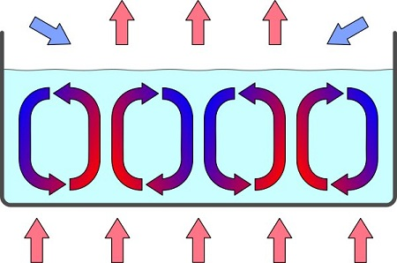
1

Slide 6
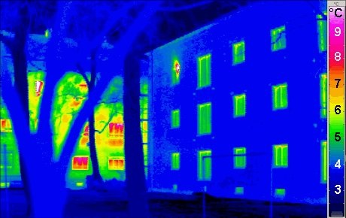
2

Slide 7
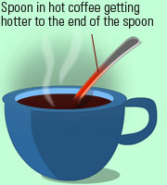
3

Slide 8
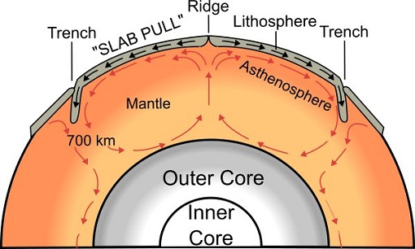
4

Slide 9
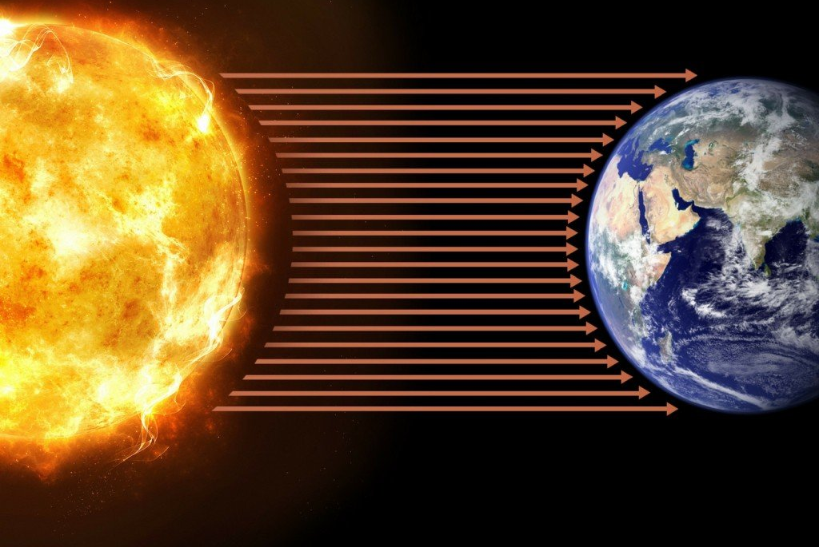
5

Slide 10
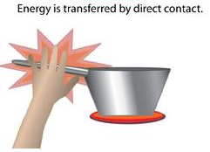
6

Slide 11
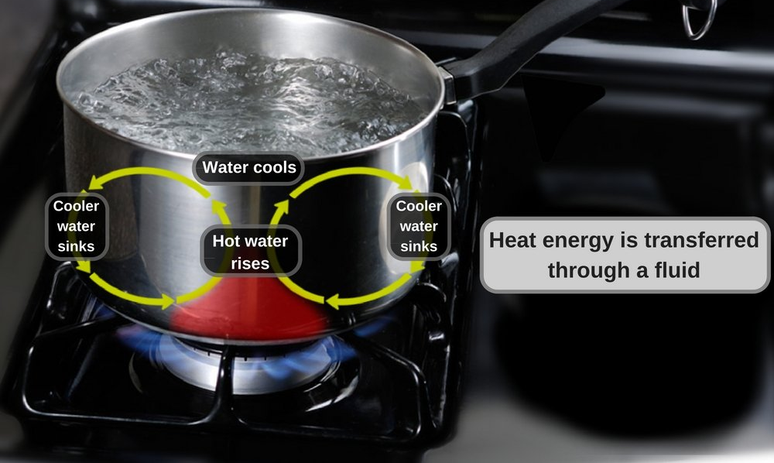
7

Slide 12
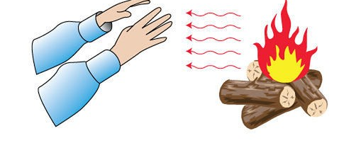
8

Slide 13
1 - convection

Slide 14
2 - radiation

Slide 15
3 - conduction

Slide 16
4 - convection

Slide 17
5 - radiation

Slide 18
6 - conduction

Slide 19
7 - convection

Slide 20
8 - radiation

Slide 21
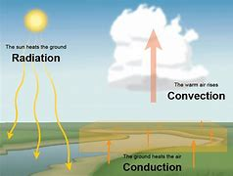
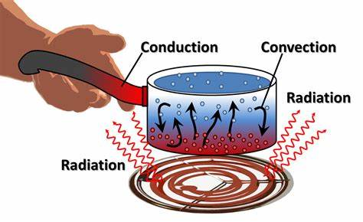
More than one type of heat transfer can take place at the same time!

Slide 22
Insulators
Are poor at letting heat (thermal energy) transfer among particles
Examples:
Wood
Plastic
Rubber
Cloth
Styrofoam
Insulation
Paper

Slide 23
Conductors
Are good at letting heat (thermal energy) transfer among particles.
Examples:
Metals (copper, lead, aluminum, steel, iron, etc)
Glass
Water

