Slide 1
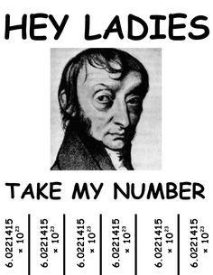
Mass of Compounds & The Mole
Outcomes:
Calculate the mass of compounds in atomic mass units
Describe the concept of the mole and it’s importance to measurement in chemistry.
Calculate the molar mass of various substances.

Slide 2
Atomic Mass
Since atoms are so SMALL, we cannot measure their MASS in LBS or KG’S.
We created a new unit called an ATOMIC MASS UNIT (amu or μ). 1 amu = 1.67 X 10⁻²⁴g
This value is found on your periodic table: 1 C atom = 12.0 amu
Chemical Formulas:
Recall that the NUMBER of ATOMS of each ELEMENT in a chemical formula are indicated by
SUBSCRIPTS.
I.e. C₉H₈O₄ (asprin) has 9 C-atoms, 8 H atoms, and 4 O-atoms

Slide 3
Chemical Formulas:
Molecular vs. Ionic Compounds:
MOLECULAR compounds (molecules) contain atoms linked together by COVALENT BONDS (electrically NEUTRAL).
IONIC compounds are NOT MOLECULES because they are composed of IONS.
Ie. You can have WATER MOLECULES, but you can’t have SALT MOLECULES.

Slide 4
Mass of Compounds:
Molecular Mass
The SUM of ATOMIC MASSES of atoms in a MOLECULE.
C₉H₈O₄ =
Formula Mass
Is the SAME as MOLECULAR mass, but with IONIC compounds.
Na₂S =
NOTE:
The terms MOLECULAR mass, FORMULA mass, MOLECULAR weight, and FORMULA weight are often interchangeable.

Slide 5
The Mole
A unit used to describe ENOUGH ATOMS to EQUAL the ATOMIC MASS(or formula mass) in
GRAMS.
Designed to be a convenient multiple like a “DOZEN”. Ex) 1 molecule of sugar (C₁₂H₂₂O₁₁) weighs 342.34 amu.
→ We CANNOT measure AMU
→We CAN measure GRAMS!
The NUMBER of MOLECULES it takes to have 342.34 GRAMS of SUGAR is 1 MOLE!
The mole explained!

Slide 6
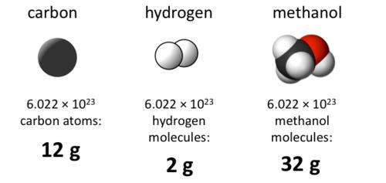
Molar Mass
Same as FORMULA mass, but with units g/mol
Is the MASS of 1 MOLE of a SUBSTANCE (like the 342.34g above).
One CARBON atom weighs 12 AMU, but an AMU is very small, and difficult to
MEASURE.
A HUGE NUMBER of carbon ATOMS will weigh 12g, and we call that NUMBER of
atoms a MOLE.
6.02 x 10²³ atoms = 1 mole AVOGADRO’S NUMBER (N_{A})

Slide 7
Molar Mass Calculations
Found by ADDING the ATOMIC MASS of all atoms in a molecule.
Examples:
Find the mass of one mole of the following:
MgCO₃
Ca₃(PO₄)₂

