Slide 1
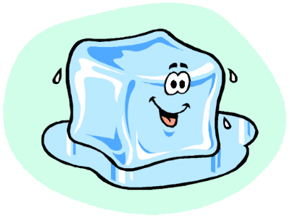
KMT of Solids & Liquids
Outcome:
Explain the properties of liquids and solids using the KMT.

Slide 2
Properties of Liquids:
Liquids:
Particles are closer together than in gases.
Particles are in constant, random motion, but only move short distances before colliding (closer together)
Liquids do not occupy the entire container, but will take on its shape.
Diffusion is slower than in gases (particles move slower)
Densities are higher than gases
Slightly compressible
INTERMOLECULAR FORCES of attraction are STRONGER in liquids– they hold the particles closer together.
Different liquids have different VISCOSITIES – the resistance to friction:
Strong IMF’s → greater viscosity (ex. oil, molasses, water!)
Weak IMF’s → lower viscosity (ex. alcohol)
Viscosity INCREASES as temperature DECREASES.

Slide 3
Properties of Solids:
Solids:
Particles are closer together, highly ordered, and are in “fixed” positions (maintain own shape).
Usually more dense than liquids (exception: water!)
Are not very compressible
Diffusion occurs only at the surface of a solid
Solids can be crystalline or amorphous

Slide 4
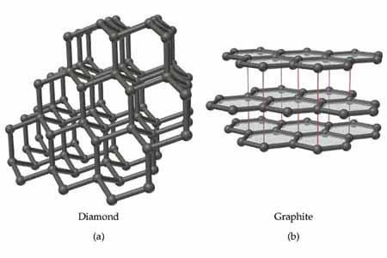
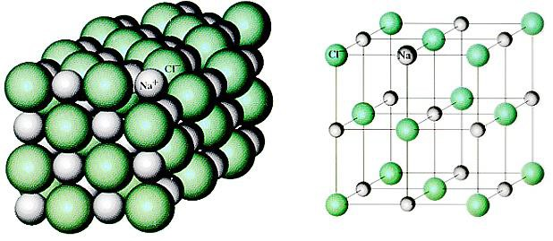
Crystalline Solids:
Are solids that have a HIGHLY ORDERED arrangement of particles. There are 4 main
types:
Covalent Network:
Atoms are bonded COVALENTLY without forming MOLECULES.
Are very STRONG. Ex. Diamond, graphite, silicon
Ionic Solids:
IONS arrange themselves in an ALTERNATING pattern.
Very STABLE structure. Ex. NaCl, CaF₂

Slide 5
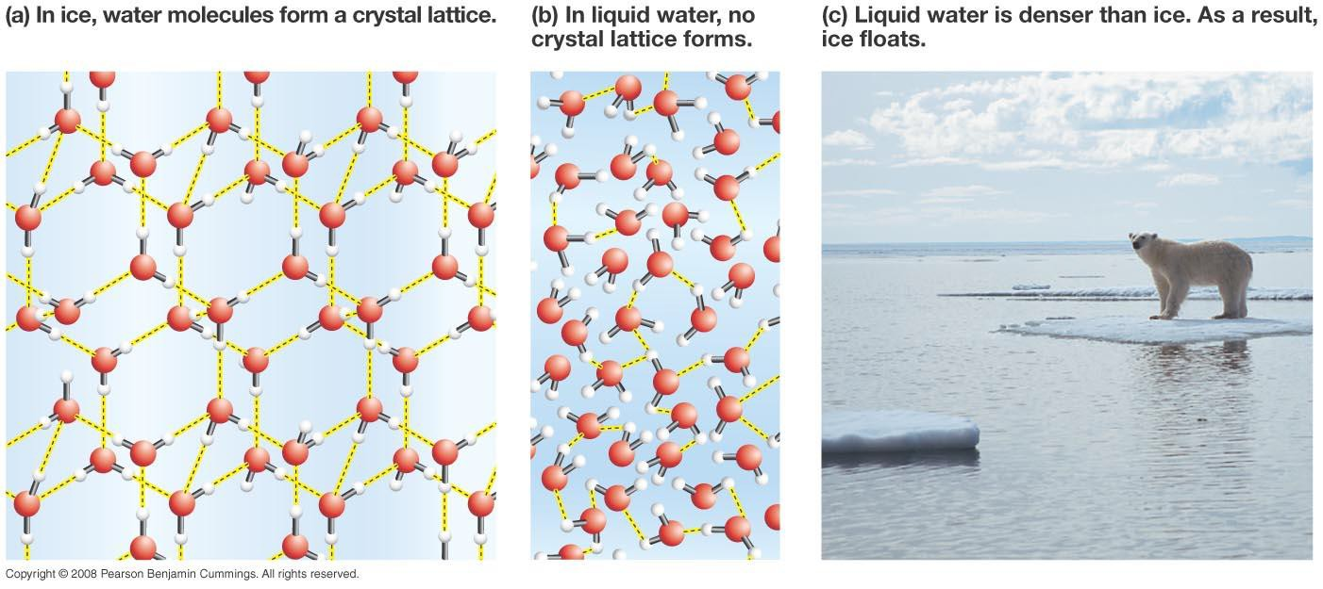
Crystalline Solids:
Molecular Solids:
Particles held together by INTERMOLECULAR FORCES.
Usually are very SOFT. Ex. I₂, S₈

Slide 6
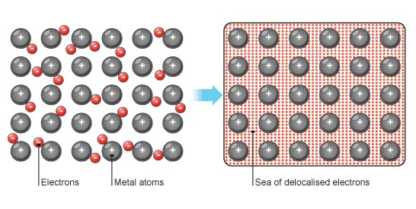
Crystalline Solids:
Metallic Solids:
Atoms held together by mobile VALENCE ELECTRONS.
Strength VARIES, Ex. Cu, Ag, Pb

Slide 7
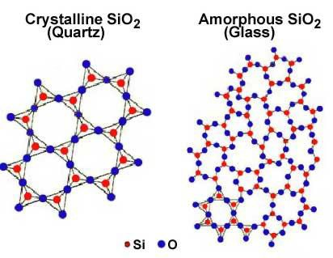
Non-Crystalline Solids:
Amorphous Solids:
Amorphous means “without shape”
Are solids that lack a REGULAR 3-DIMENSIONAL ARRANGEMENT of atoms.
Are like super cooled LIQUIDS.
Ex. Glass, rubber, plastic.

Slide 8
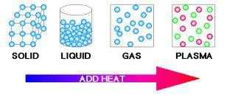
States of Matter:
The state that a substance at room temperature depends on the strength of the intermolecular forces:
Strong IMF’s → Solids at room temperature
Weaker IMF’s → Liquids at room temperature
Weakest IMF’s → Gases at room temperature
As we add ENERGY (HEAT) to a solid, the particles gain energy, and will eventually get enough energy to overcome the IMF’s, and undergo a phase change.
The reverse is true with cooling (removing energy)

Slide 9
Summary: KMT explained
Property | Gas | Liquid | Solid
Compressibility | Highly compressible | Slightly Compressible | Very slightly / not compressible
Density | Low Density | Higher density | Usually highest density
Volume | Fills container completely | Does not expand to fill container | Maintains its volume
Shape | Assumes shape of container | Assumes shape of container | Retains its shape
Diffusion | Rapid diffusion | Slow diffusion | Very slow diffusion at surfaces
Expansion when heated | High expansion upon heating | Low expansion on heating | Low expansion on heating
Strength of intermolecular forces (IMF) | Weak/no IMF’s | Medium IMF’s | Strong IMF’s

