Slide 1
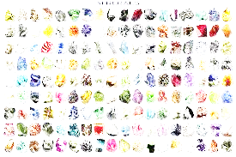
MINERALS

Slide 2
Minerals:
The pure, natural building blocks of rock.
All minerals are non-living.
All minerals occur naturally, synthetic (mixed together) substances like steel (iron and carbon mix) are not minerals .
https://www.youtube.com/watch?v=9l7JqonyoKA
Minerals usually contain several substances. For example iron is found in pyrite (iron combined with sulphur)
Minerals are crystals:
-crystals are tiny geometric shaped particles connected in a repeated pattern.

Slide 3
Properties of Minerals
Lustre: A minerals shininess
Cleavage: The way minerals split into smaller pieces (because of their crystal structure)
Hardness: How hard (the ability to scratch) is a mineral compared to other minerals.
Colour: The specific colour of a mineral (shade, coloured vs colourless)
https://www.youtube.com/watch?v=ZtKHCnPoW30

Slide 4
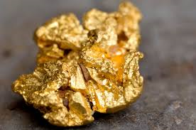
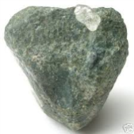
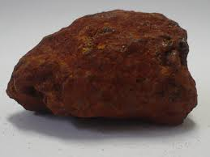
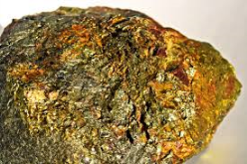
MINERALS AND SUBSTANCES THEY CONTAIN
Mineral | Location | Valuable Substance | Properties | Uses
Gold | Northern Ontario | Gold | Soft, can be shaped, doesn’t rust | Money, jewellery
Diamond | South Africa, NWT | Diamond | Extremely hard, reflects light | Cutting tools, jewellery
Hematite | Northern Ontario | Iron | Very strong, Mixes well with other minerals | Steel, stainless steel
chalcopyrite | Ontario | Copper | Conducts electricity, can be easily shaped | Wiring, plumbing, coins

Slide 5
ASSIGNMENT
Copy the following table. Research 5 new minerals filling in all the sections of information for each.
MINERALS AND SUBSTANCES THEY CONTAIN
Mineral Picture and name | Location(s) | Valuable Substance | Properties At least 2 | Uses At least 2

