Slide 1
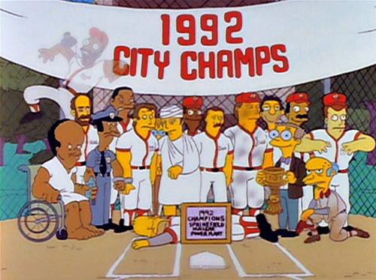
Atomic Mass & Isotopes
https://www.pastemagazine.com/blogs/lists/2014/07/the-100-greatest-simpsons-guest-stars.html?p=6
Outcome:
Determine average atomic mass using isotopes and their relative abundance. Include: Atomic mass
unit (amu)

Slide 2
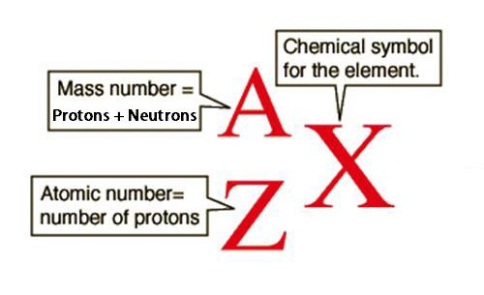
Periodic Table Review
Recall from Senior 1:
→ Atomic number = number of PROTONS
→ Atomic mass = number of PROTONS + number of NEUTRONS
→ Elements are usually denoted as follows:
http://hyperphysics.phy-astr.gsu.edu/hbase/nuclear/nucnot.html
12
Ex) ₆𝐶

Slide 3
More about atoms…
Protons Identify the element
The number of protons CANNOT change without changing the ELEMENT.
ie. If an atom has 6 protons, it MUST be carbon
In Neutral Atoms Electrons = Protons
The number of electrons CAN change, but it forms an ION.
Neutrons Stabilize the Nucleus
Neutrons are NEUTRAL and simply keep protons from REPELLING each other.

Slide 4
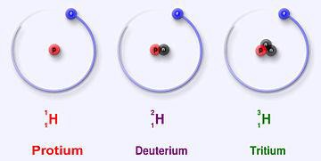
Isotopes:
Isotopes are atoms of the same ELEMENT (same # of PROTONS), with different numbers of
NEUTRONS.
Neutrons STABILIZE the nucleus, which can be done in different ARRANGEMENTS.
They have the same ATOMIC number, but different MASSES
The AVERAGE mass of an isotope for an element is a PROPERTY of that element.
Isotopes are usually represented as SODIUM-24 or ²⁴Na
Example:
Hydrogen has 3 naturally occurring isotopes:
Hydrogen Isotopes Analogy
https://en.wikipedia.org/wiki/Isotopes_of_hydrogen

Slide 5
Atomic Mass
Atomic Mass Unit (amu, u, or µ):
Is 1/12th the mass of a C-12 atom.
The reasons for using the C-12 isotope:
It is very COMMON
It results in nearly WHOLE number MASSES for most other elements
It gives HYDROGEN (lightest element) a mass of nearly 1AMU
It is extremely small! 1amu = 1.66x10⁻²⁷kg
Average Atomic Mass:
Most elements have isotopes, meaning that there are atoms of the same element with different MASS.

Slide 6
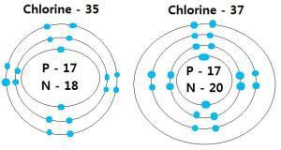
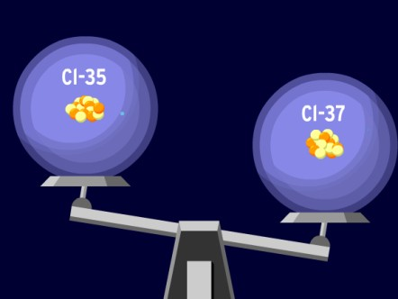
Example:
Chlorine has two common isotopes: Chlorine-35 and Chlorine-37.
https://2009rt8sciafifa.wordpress.com/chemical-interactions-2/
Any SAMPLE of chlorine atoms will have atoms of BOTH ISOTOPES.
For most elements the AMOUNTS of each ISOTOPE in any SAMPLE is CONSTANT.
Because the composition is constant, we can use an AVERAGE MASS for chlorine, taking the amount of each isotope into account.
This percentage is called RELATIVE ABUNDANCE.
A sample of chlorine has 75% chlorine-35, and 25% chlorine-37.
The average mass of Cl should be between 35 and 37amu (but closer to 35)

Slide 7
How do we calculate average mass?
You need to know the RELATIVE ABUNDANCE of all isotopes.
Isotope | Abundance (%)
Silicon-28 | 92.23
Silicon-29 | 4.67
Silicon-30 | 3.10
Next, MULTIPLY the MASS of each isotope with its ABUNDANCE. (this WEIGHTS each isotope)
Note: Use the exact mass of each isotope if given.
Finally, ADD the WEIGHTED MASSES to get the average atomic mass.

Slide 8
Try these ones…
Given the information below, find the average atomic mass of elemental Magnesium.
Isotope | % Natural Abundance
Magnesium-24 | 78.70
Magnesium-25 | 10.13
Magnesium-26 | 11.17

Slide 9
Try these ones…
Elemental Boron is a combination of two naturally occurring isotopes: Boron-10 has a relative abundance of 19.78%, and boron-11 has a relative abundance of 80.22%.

